Slide 4
Webinar: Key takeaways
Dynamic Mapping Tools: Visualizing map data and metadata with support for custom styles using vector and raster datasets.
Collaborative Zoning & Surveys: Interactive tools for sketching, evaluating MPAs, and collecting spatial data on ocean use from stakeholders.
Understand how user-friendly tools, such as map-based surveys and zoning scenario evaluations can streamline decision-making.
Gain insight into leveraging SeaSketch’s open API for custom geo-processing and reporting tools tailored to your project's needs.

Slide 5
MSP4BIO
Improved Science-Based Maritime Spatial Planning to Safeguard and Restore Biodiversity in a coherent European MPA network
Webinar: Empowering Marine Spatial Planning with SeaSketch
15 May 2025, online
www.msp4bio.eu
@MSP4BIO_project
MSP4BIO

Slide 6



MSP4BIO: KEY FACTS
6 TEST SITES
4 PILLARS
3 SISTER PROJECTS
DURATION
August 2022-July 2025
BUDGET
3,490,500 EUR
18 PARTNERS

Slide 7




MSP4BIO: MAIN GOAL
Convention on Biological Diversity (CBD) Post-2020 Global Biodiversity Framework
EU Biodiversity Strategy (EUBS) 2030
EU Green Deal

Slide 8
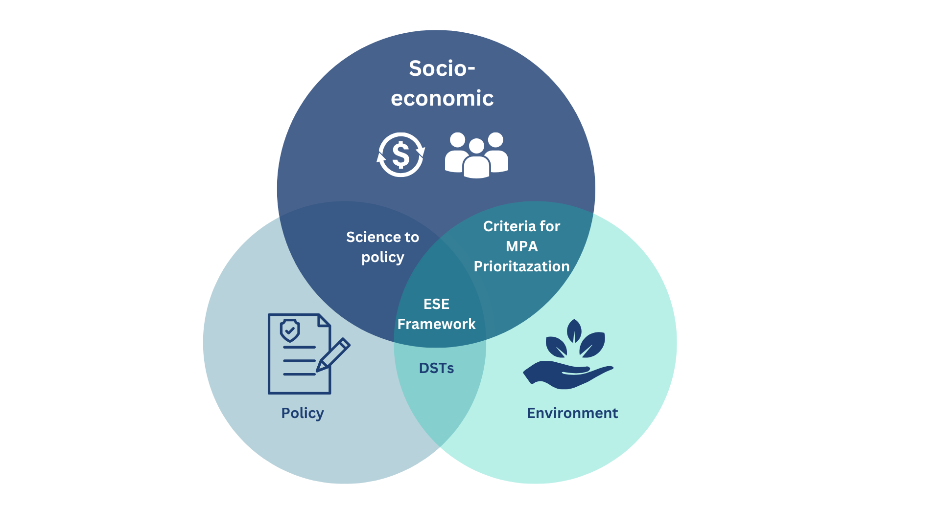
MSP4BIO: PILLARS
Pillar 1 - Environment: MSP4BIO will improve the knowledge base and criteria for better prioritization of areas for biodiversity restoration and conservation.
Pillar 2 - Policy: MSP4BIO develops solutions that support coherent policy implementation and effective mainstreaming of biodiversity into relevant policies.
Pillar 3 - Socio-economic: Develops a framework for a more integrated and flexible strategic and spatial integration between MSP and MPAs, validated in 6 test sites in all 5 European Sea Basins.
Pillar 4 – Integration: MSP4BIO integrates the socio-economic considerations in MPA prioritization and management.

Slide 9



MSP4BIO: OBJECTIVES
SO1. Improve the science base for the description of MPAs and EBSAs and, identification of new, restoration, enlargement and management of existing MPAs.
SO2. Develop and demonstrate a novel flexible management framework that integrates ecological and socio- economic dimensions for the prioritization of strategic and spatial conservation-management measures.
SO3. Strengthen the role of MSP as an integrative framework to support the coherent implementation of relevant policies (MSFD, WFD, MSPD, BHD, Common Fisheries Policy (CFP), etc.) as well as the EUBS2030 and the CBD post-2020.
SO4. Improved biodiversity and natural capital integration into public and business decision-making at all levels for the protection and restoration of ecosystems and their services.

Slide 10
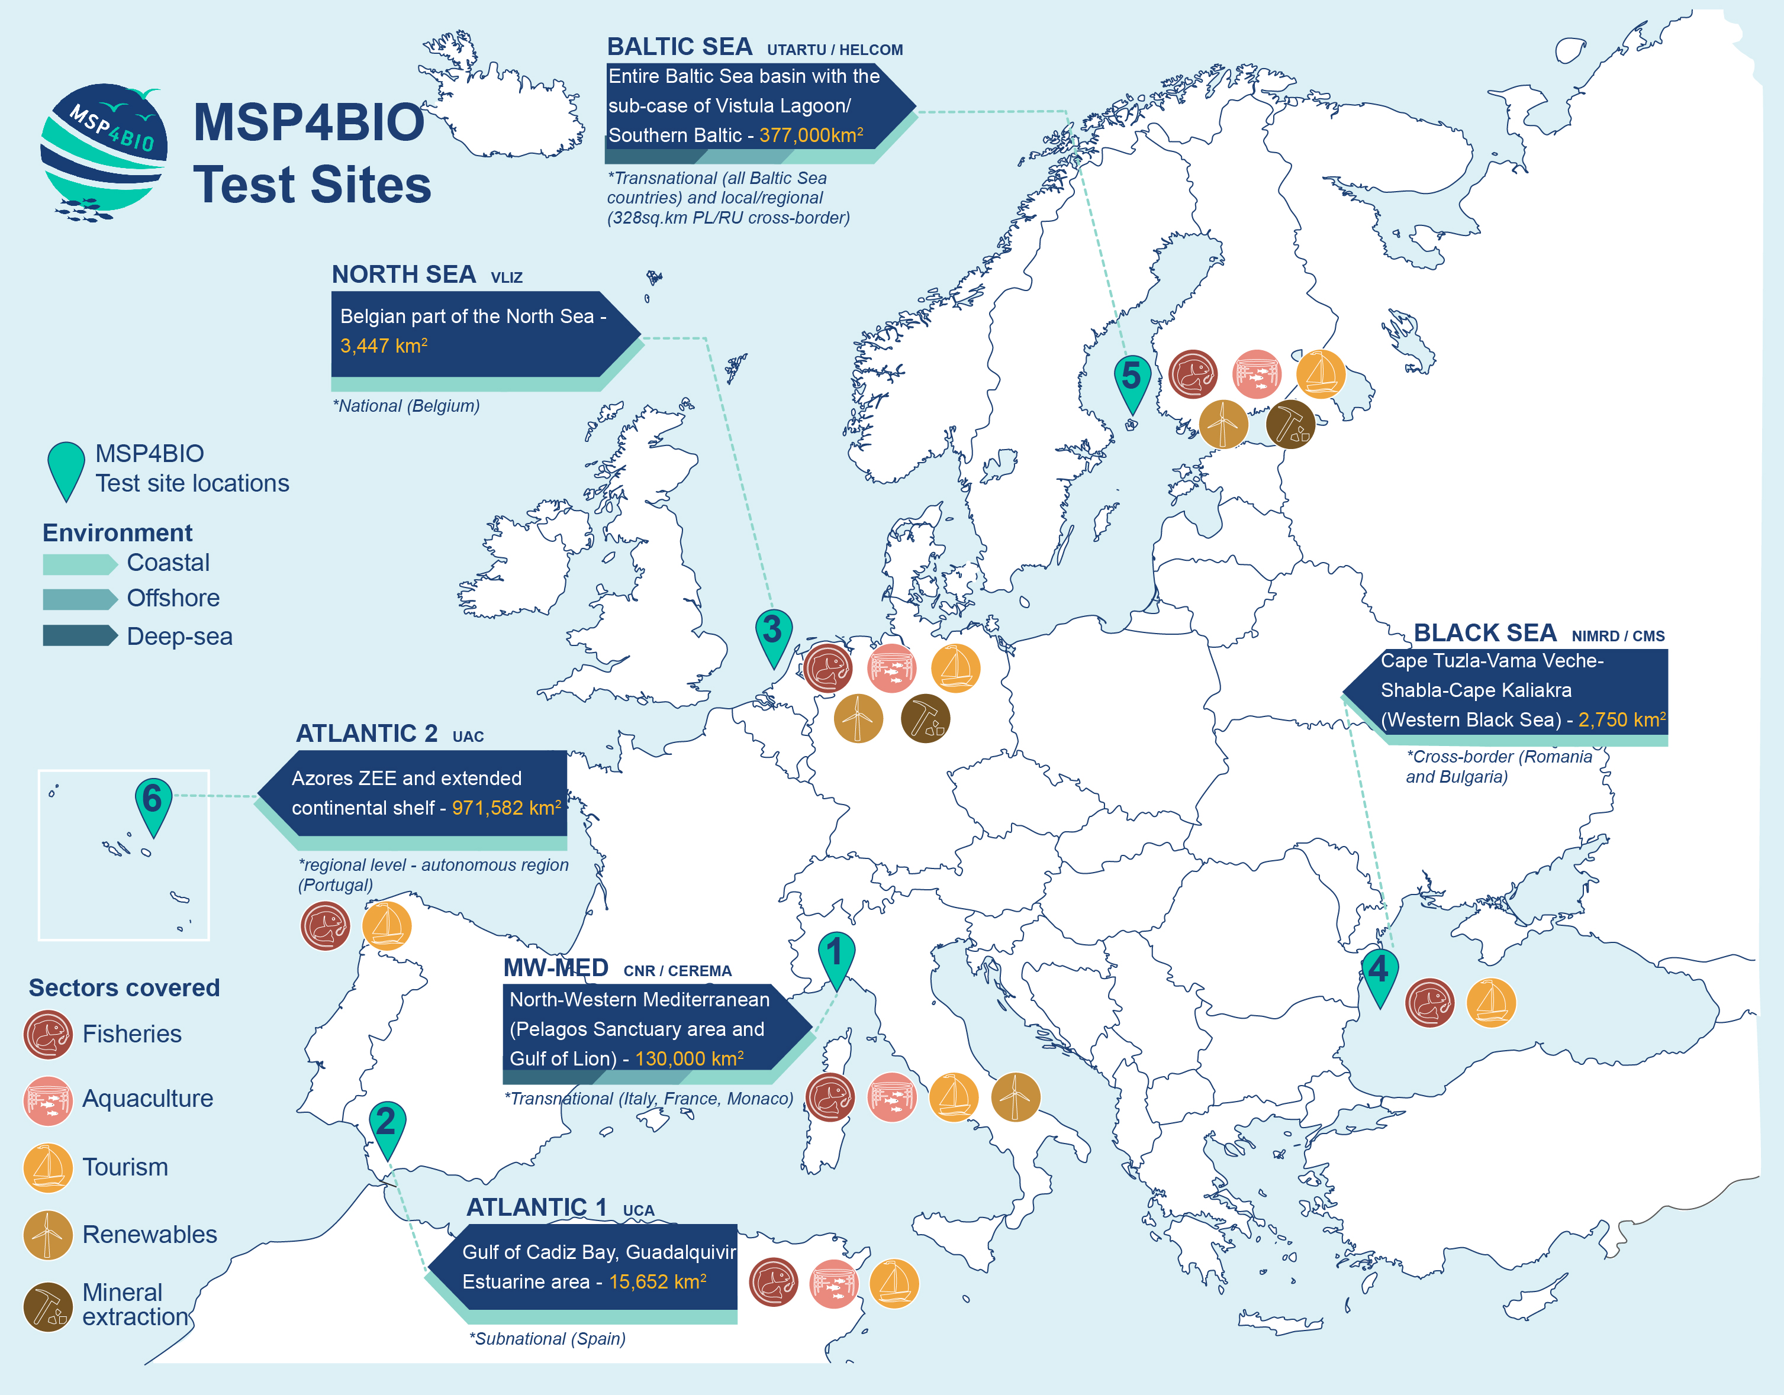
BALTIC SEA
Transboundary sea basin
Ecosystem under multiple human-induced pressures
Need for more MPAs designated areas to achieve the regional goal
Need for a coordinated plan for human activities
BLACK SEA
Cross-border area: 2 countries
Diversity of marine domains
MPAs Support huge biodiversity and ecosystem services
MPAs fragmented and do not have operational management
ATLANTIC 1 – GULF OF CADIZ
Hot spots with special needs for MSP and MPA
Need for improvement of MSP and stronger consideration of sea-land interactions in planning
Human activities threaten MPAs in their vicinity
NORTH SEA – BELGIAN AREA
Well studied and monitored area
Need for spatial strategy for pelagic biodiversity conservation
Need for geographical biodiversity assessments units
NW-MED
Governance complexity as area is shared between 3 countries
Large spatial scale
Diversity of marine domains
Multiplicity of human activities
ATLANTIC 2 – AZORES (Graciosa Island)
Rich habitat diversity – knowledge gaps in offshore and coastal areas
Need for strategies to enlarge MPA network and for “fully protected areas”
No MSP approved yet

Slide 11



MSP4BIO: KEY RESULTS
MPA/MSP strategic integration framework
Policy coherence solutions to strengthen MSPs compatibility with the new biodiversity policy requirements
EU-wide overview of biodiversity data availability
Integrated modular management framework allowing for better integration of biodiversity considerations in MSP, wider participation and adaptation
Ecological Toolkit ensuring better integration of data in decision making (improved DSTs)
Participatory development of integrated trade-off scenarios. Good management practices for blue economy sectors.
6 demonstrators at different governance levels producing site specific solutions

Slide 12
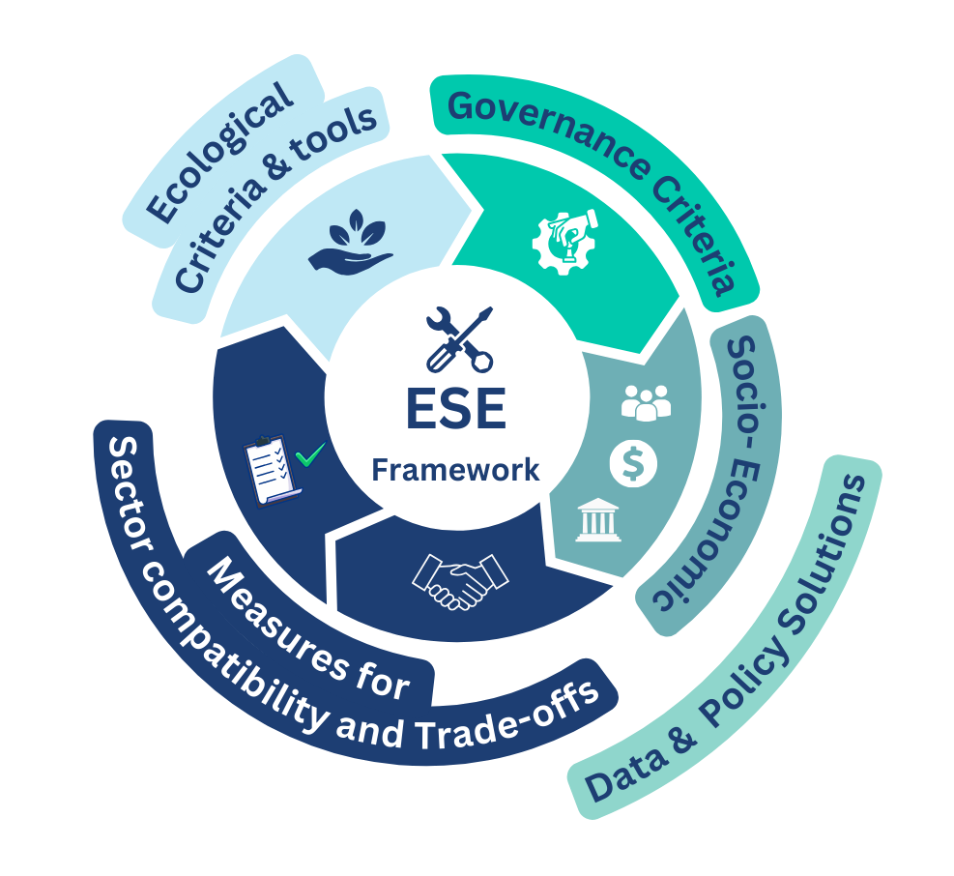
MSP4BIO ESE Framework – biodiversity mainstreaming in MSP

Slide 13
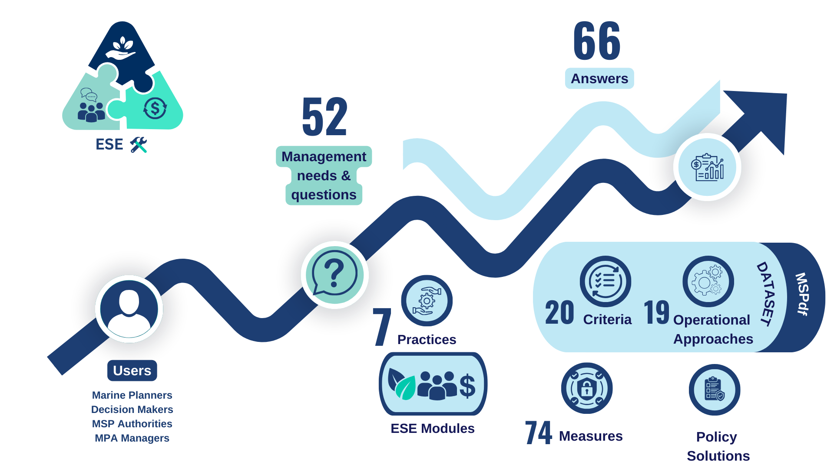
MSP4BIO – ESE Framework in numbers

Slide 14
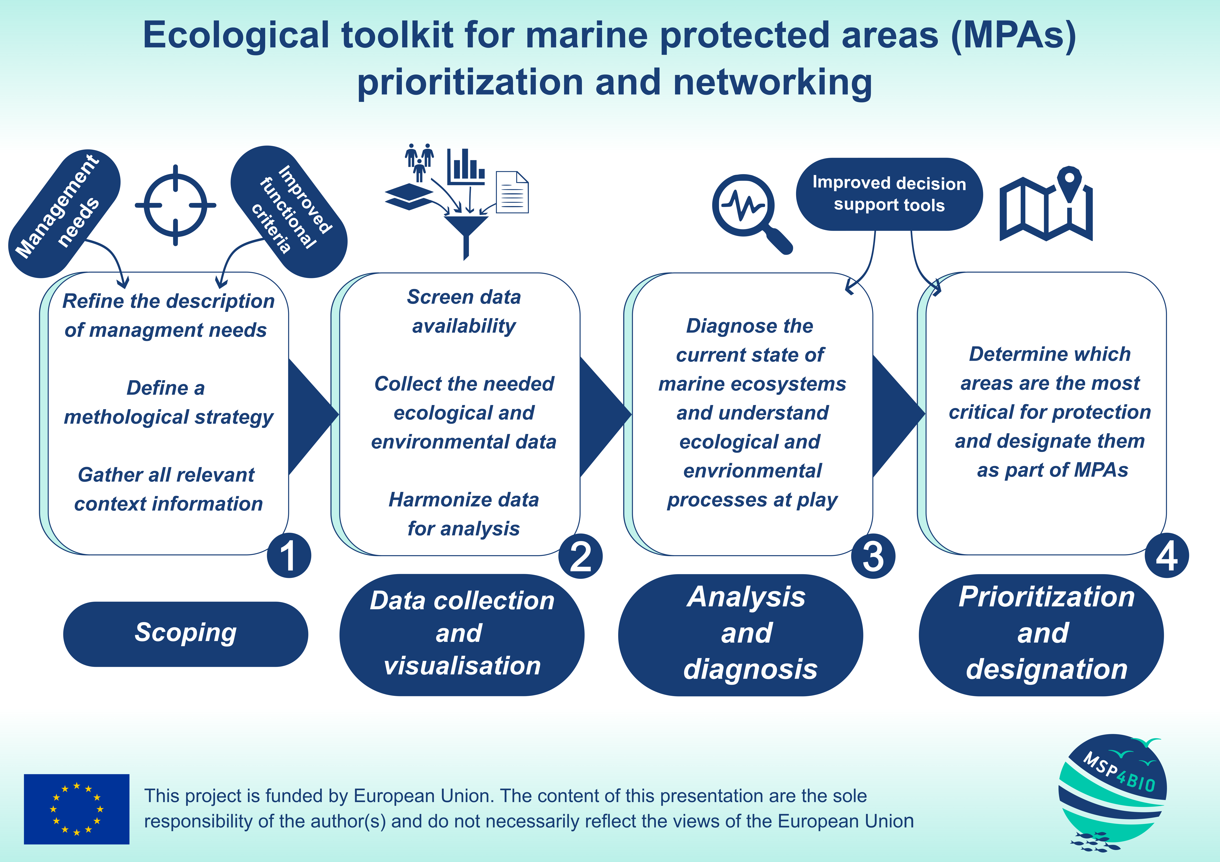
MSP4BIO – Ecological Toolkit

Slide 15
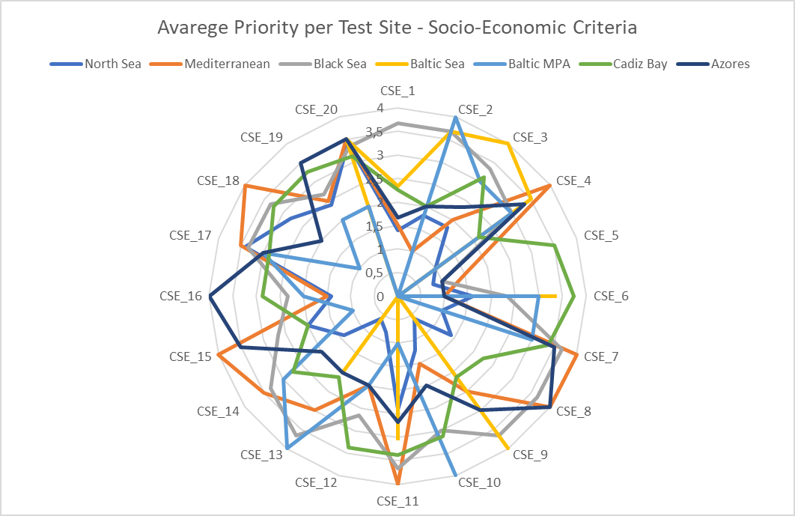
MSP4BIO – Socio-Economic Criteria
CoP members of all test sites ranked the following six criteria as the most important:
SEC_3. Area is important for the development of blue economy activities;
SEC_5. Area is important for dredging;
SEC_6. Area is important for locally-caught seafood;
SEC_7. Area has high scenic and/or aesthetic value;
SEC_16. Area is important because allows the access to relevant areas for the marine users.
https://www.frontiersin.org/journals/marine-science/articles/10.3389/fmars.2024.1358950/full
Notes:
define socio-economic criteria for prioritizing proposals related to new marine protected areas, boundary adjustments, area relocations, and network corridors within marine management approaches. The study also focuses on identifying ecosystem services (ES) that address the social dimensions of various spatial management approaches in the marine realm. The presented method quantifies nature’s significance to human communities through stakeholder perceptions, bridging the gap between human activities and ecosystem services. The research defines essential socio-economic criteria, identifies the corresponding ecosystem services, and assesses their societal values within the socio-ecological system of a specific area, thereby enhancing the effectiveness of marine management processes such as marine spatial planning and marine protected areas.

Slide 16
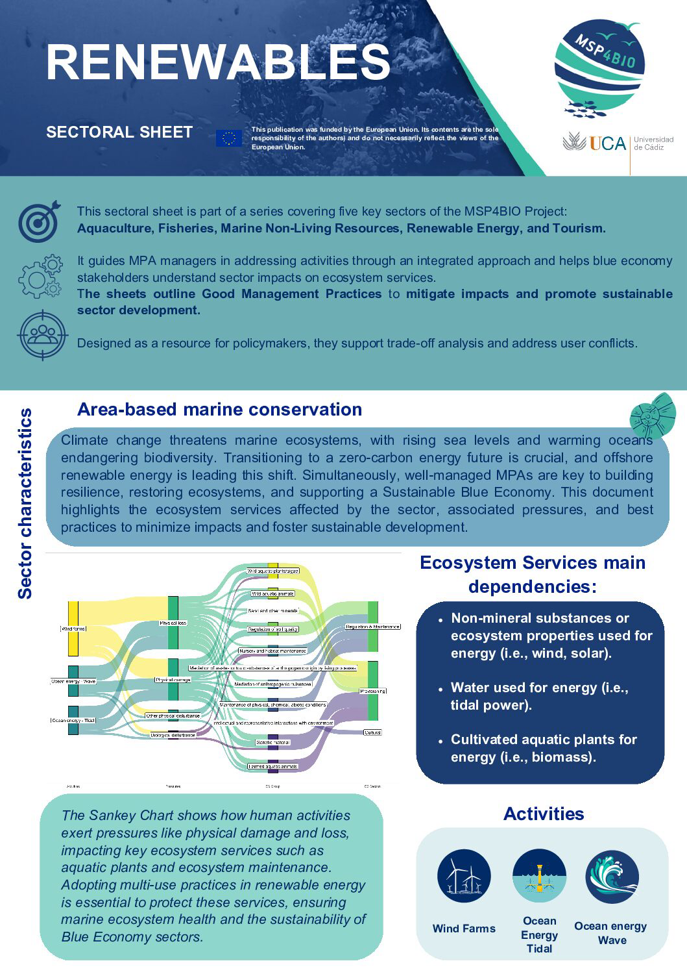
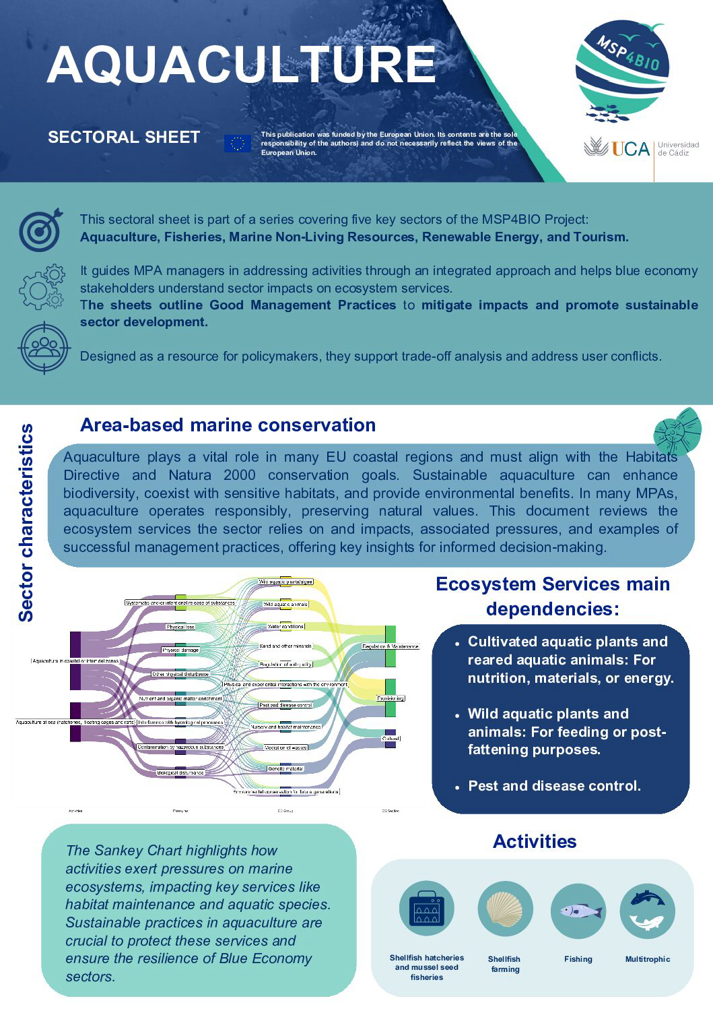
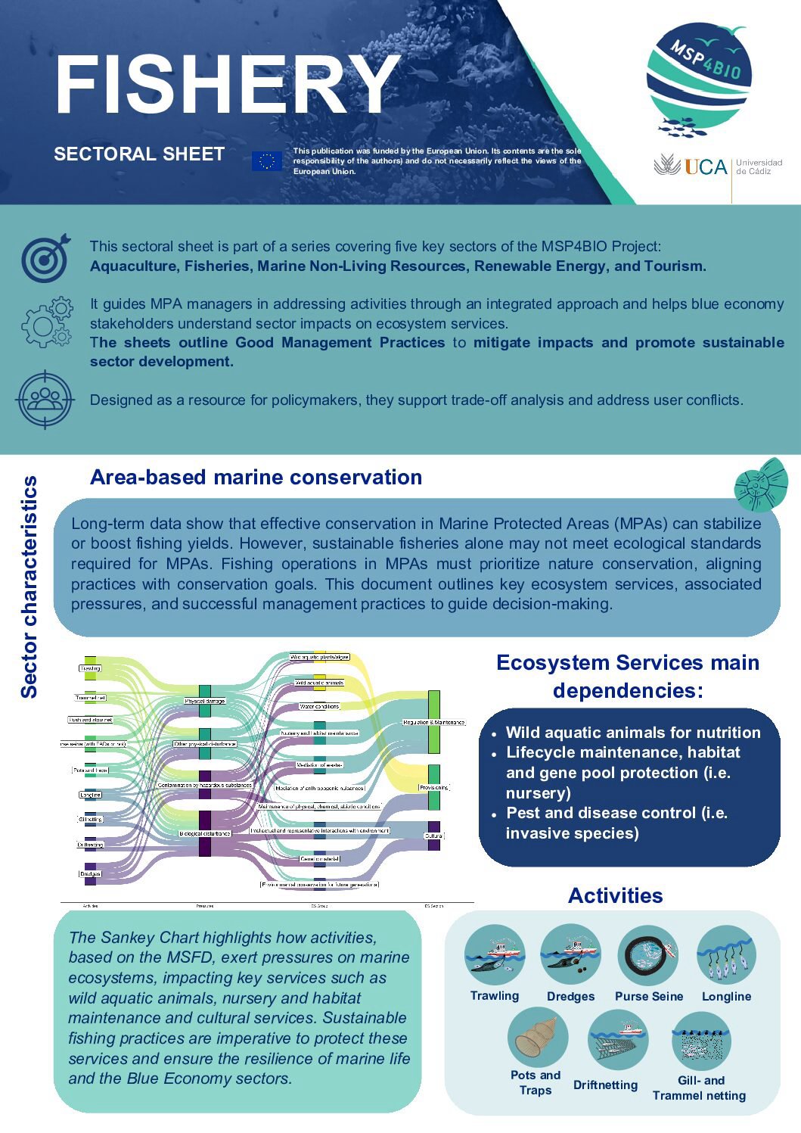
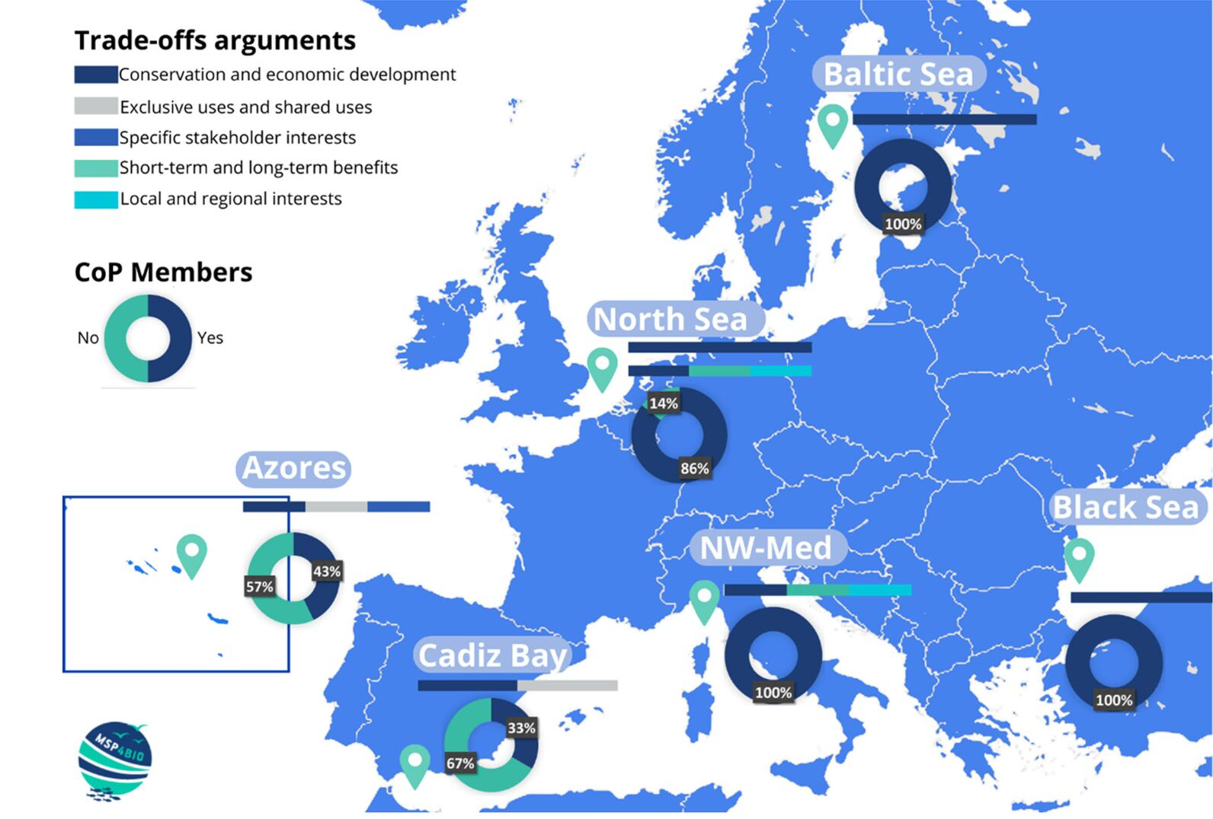
MSP4BIO – trade-off scenarios and good management practices
Notes:
Participatory development of integrated trade-off scenarios. Good management practices for blue economy sectors.

Slide 17
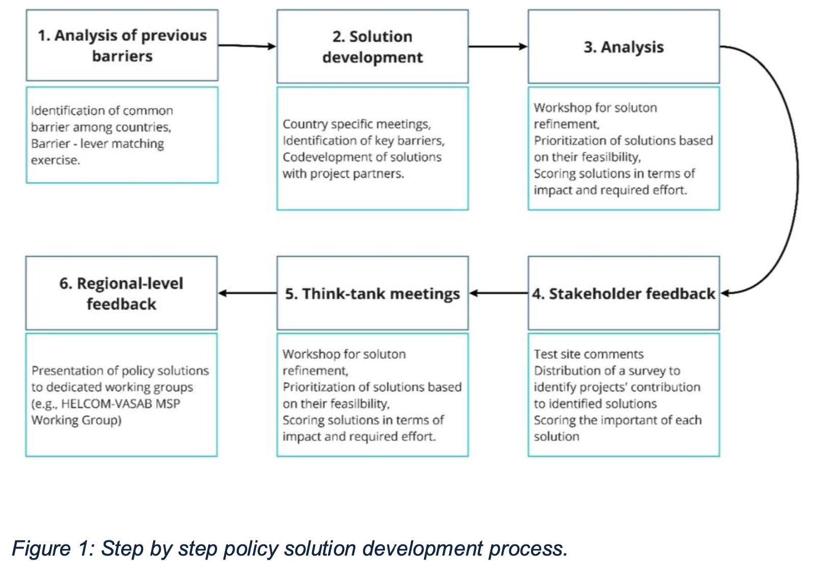
MSP4BIO – policy barriers and solutions
Notes:
Participatory development of integrated trade-off scenarios. Good management practices for blue economy sectors.

Slide 18
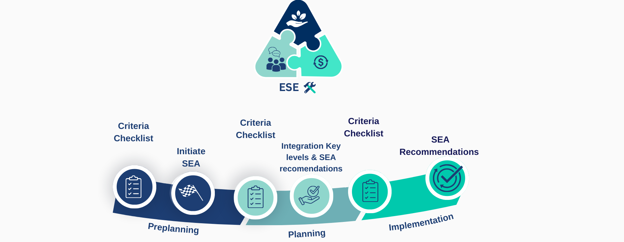
MPA MSP integration guide

Slide 19

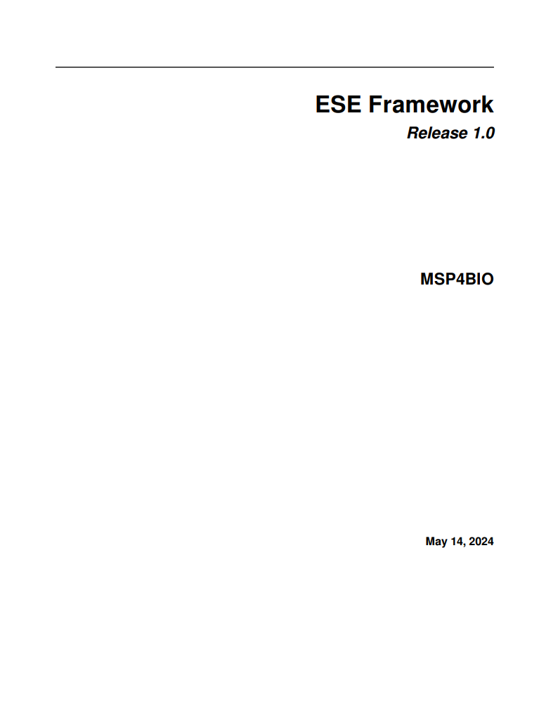


MSP4BIO – ESE Framework online tool/document
PDF file
https://ese.tools4msp.eu

Slide 20
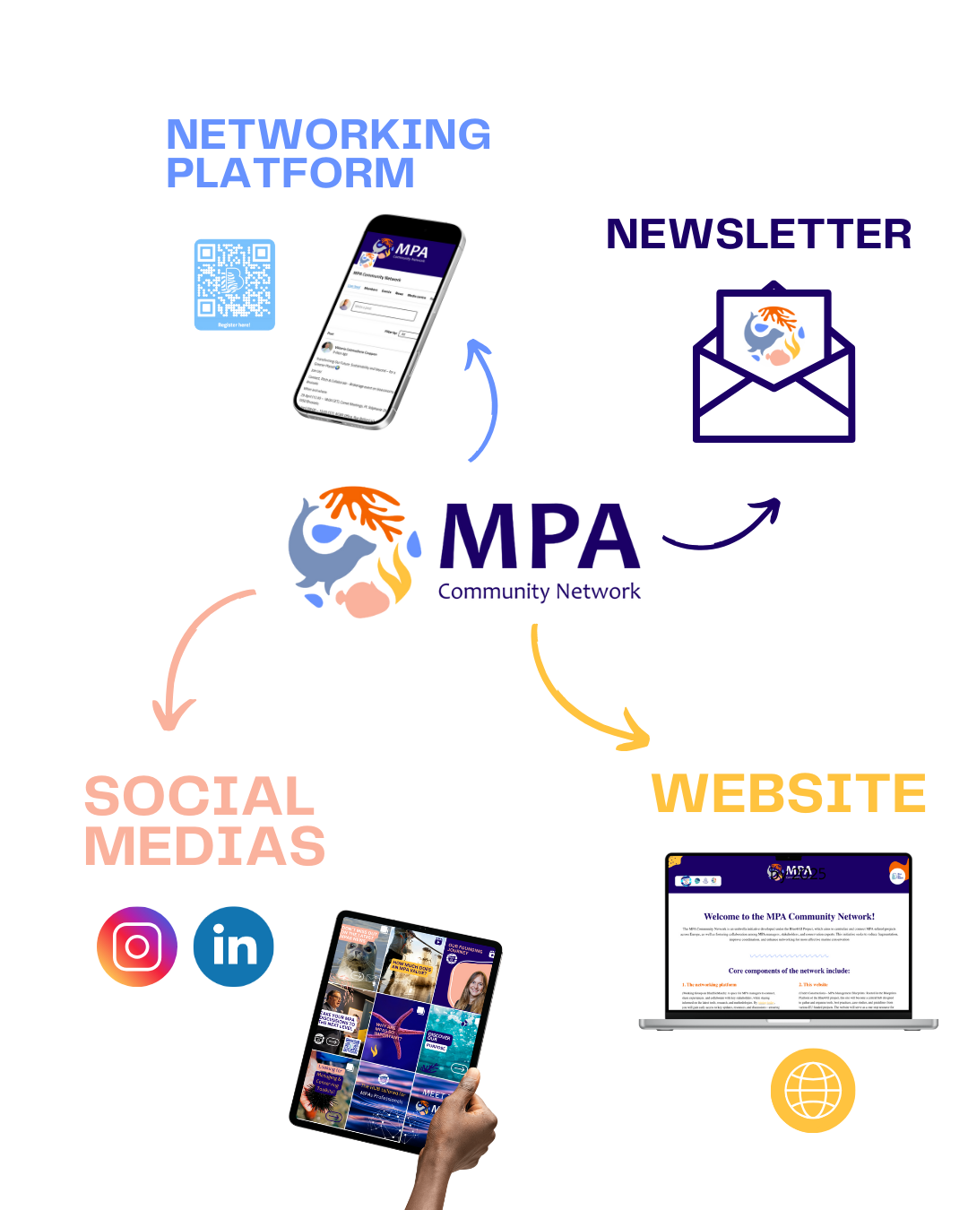
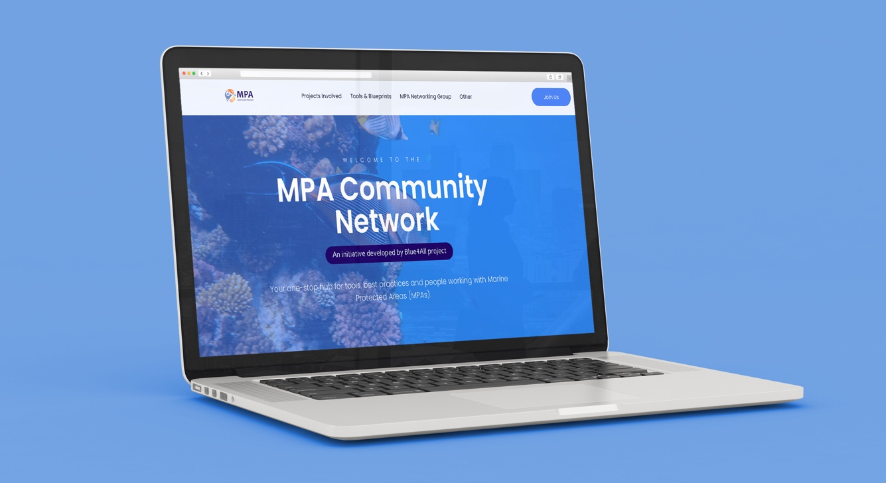
MSP4BIO results: exploitation and legacy

Slide 21
MSP4BIO joined the MPA Community Network! Interested? Join us!

Slide 22


MSP4BIO
FINAL EVENT
Date: 2nd - 4th of July 2025
Location: CNR-ISMAR Headquarter, Venice, Italy.
REGISTRATION IS OPEN: Register here.
WWW.MSP4BIO.EU

Slide 23

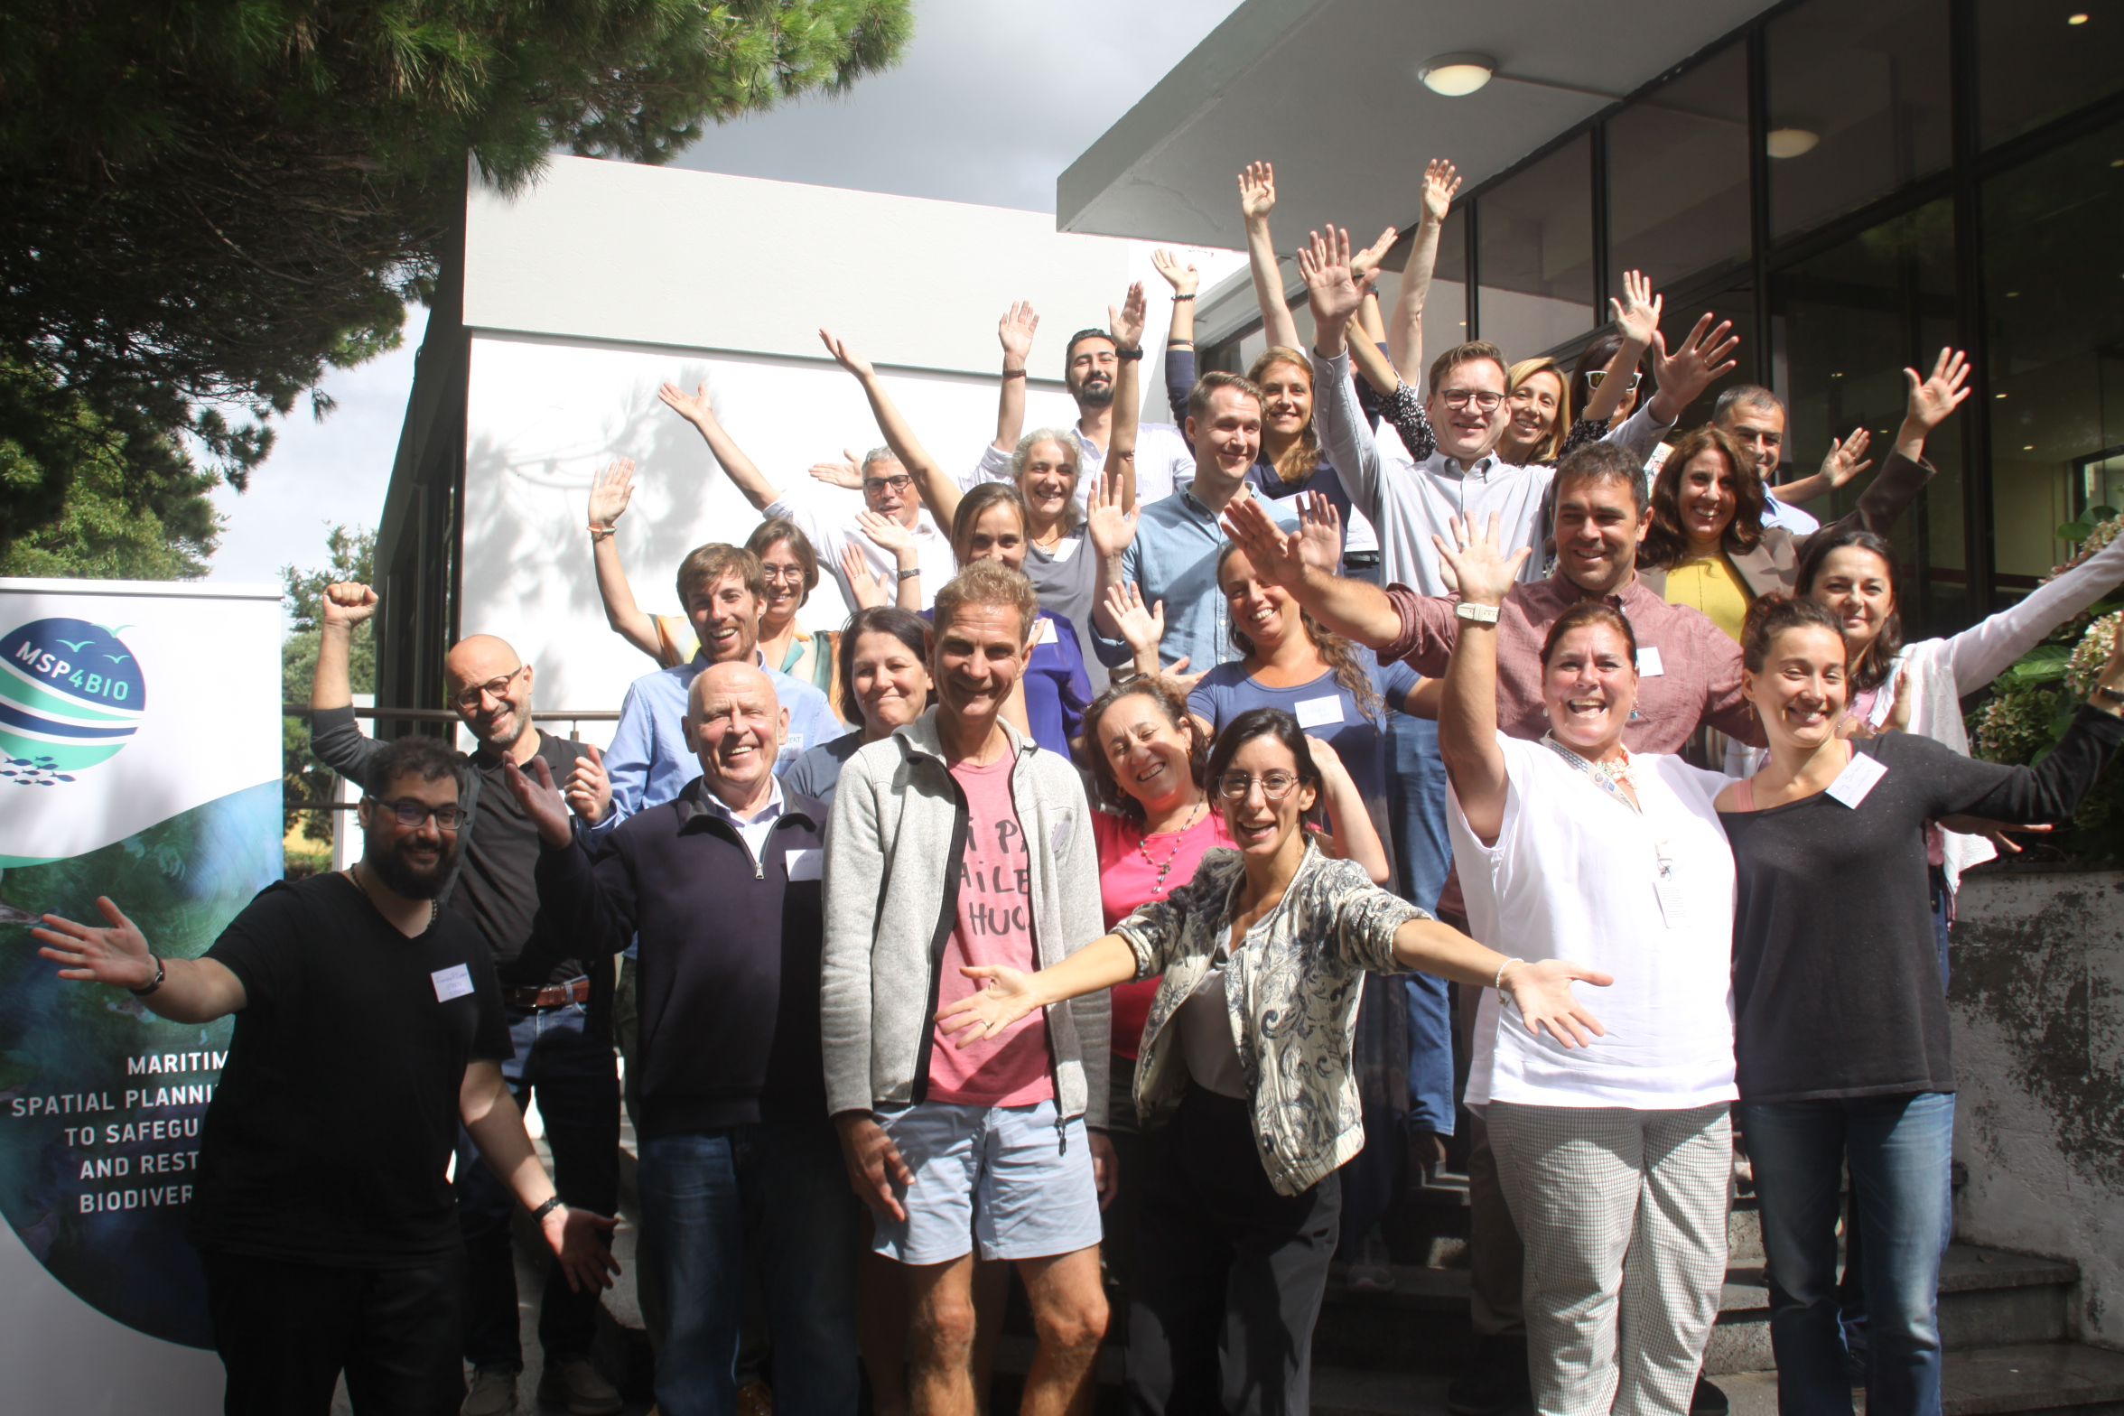















MSP4BIO: PARTNERS

Slide 24

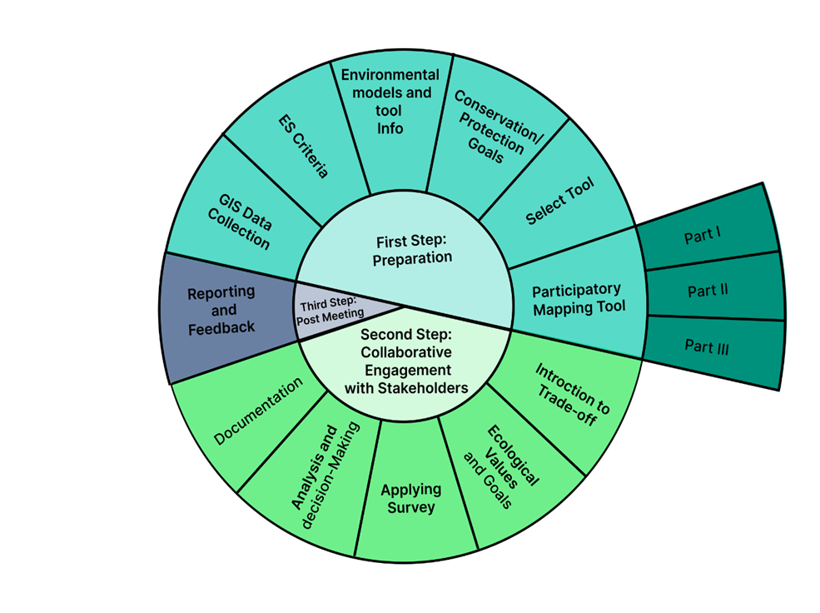
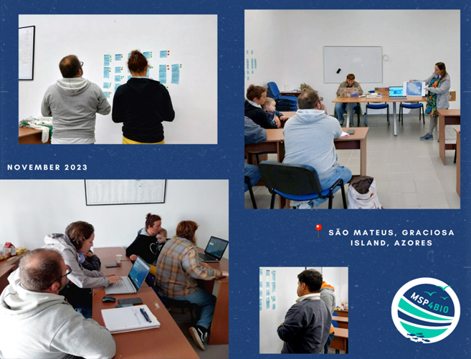
Azores test side
6 PILOTS
4 PILLARS
3 SISTER PROJECTS
Participatory mapping survey and trade-offs analysis (SeaSketch tool).
Following step-by-step methodology (method: workshops and online meetings).
DURATION
August 2022-July 2025
BUDGET
3,490,500 EUR
18 PARTNERS
Third CoP Interaction – Graciosa Case Study Azores.
Source: https://msp4bio.eu/third-community-of-practice-cop-interaction-graciosa-case-study/
Source: Gutierrez D., Calado H., De Bruyn A., et al., (2024) Trade-offs method for protection and restoration in MSP – ESE3 (Deliverable – D4.3., under the WP4 of MSP4BIO project (GA n° 101060707).

Slide 25
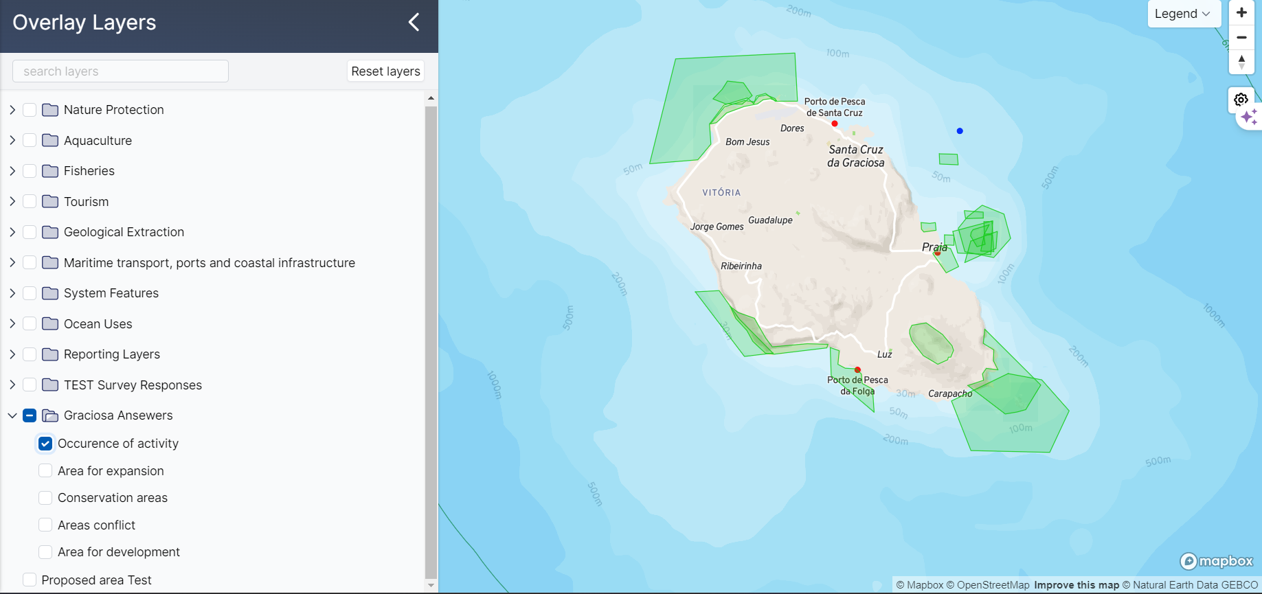
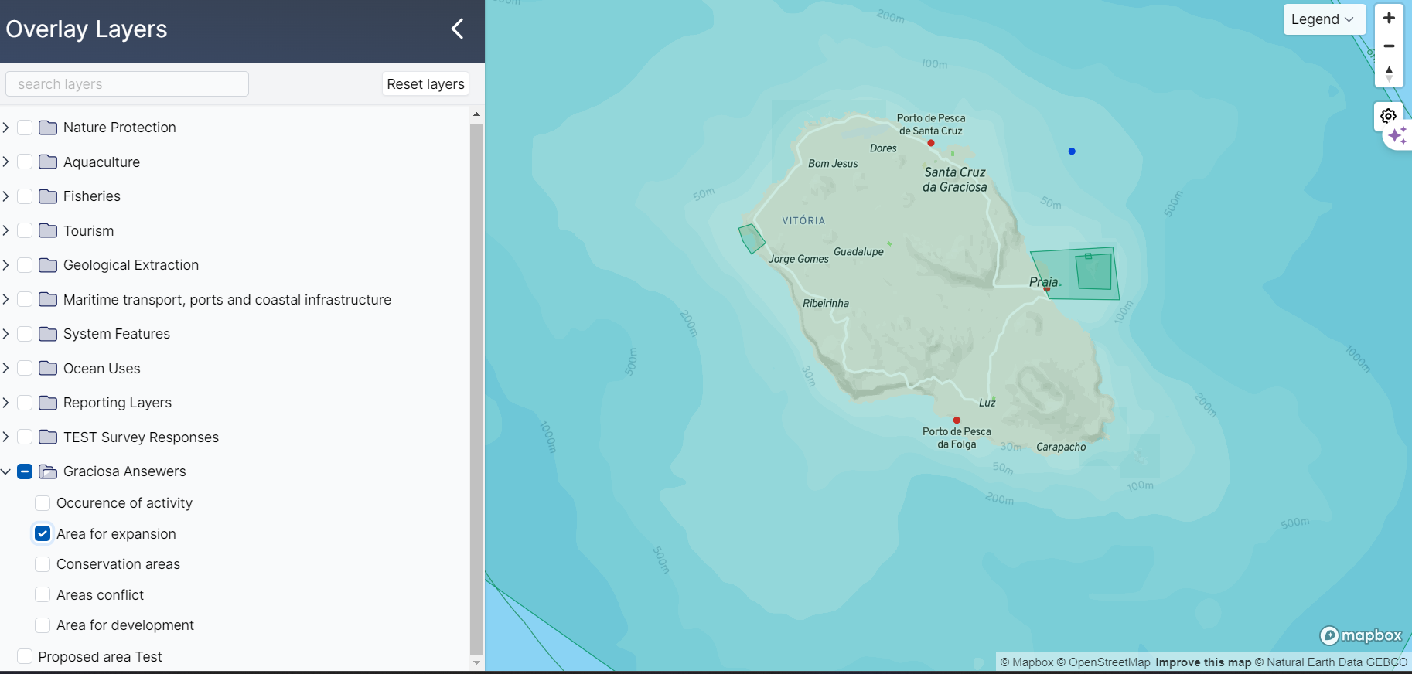
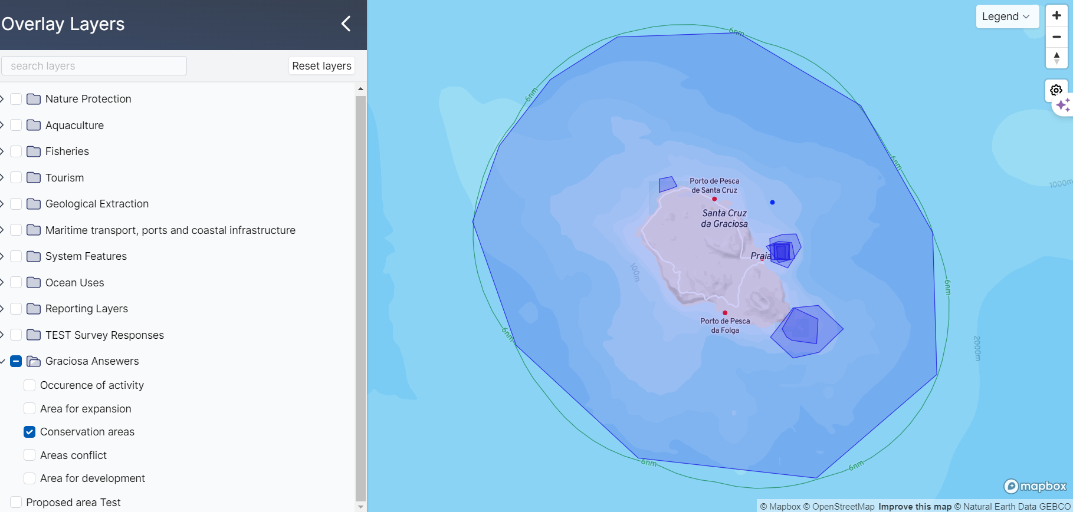
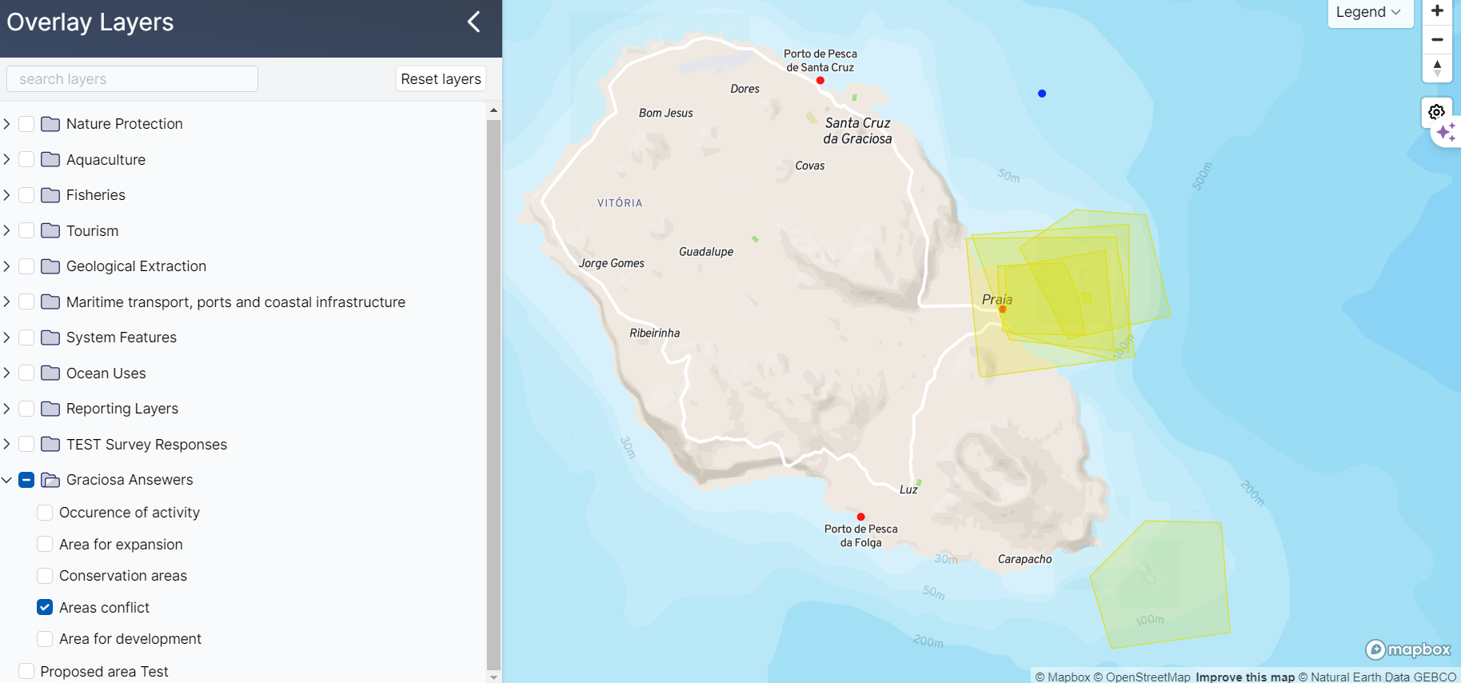
Notes:
https://www.seasketch.org/graciosa/app/overlays

Slide 26
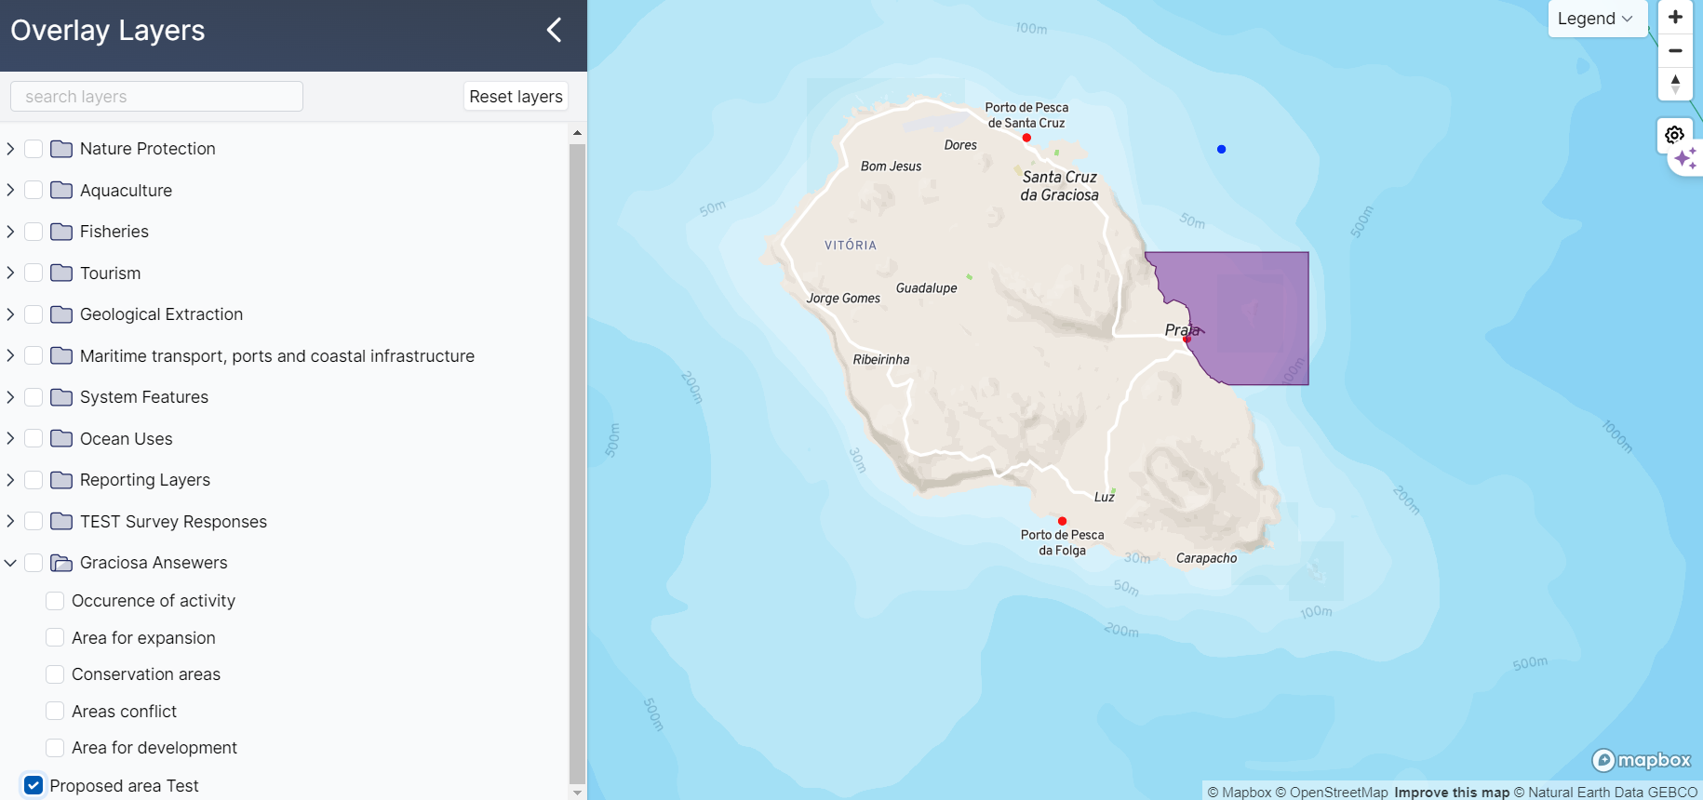


Slide 27
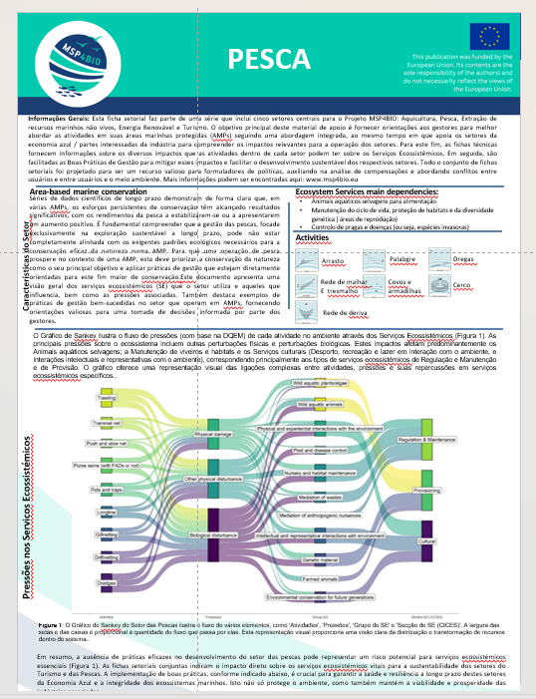
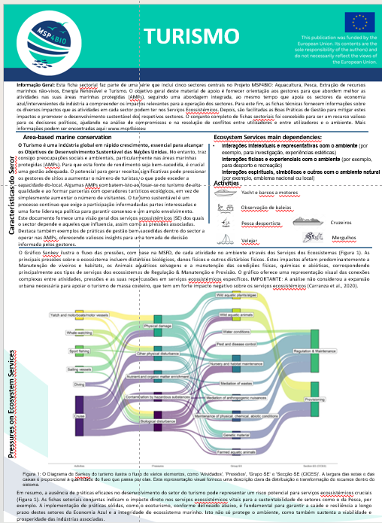



Slide 28
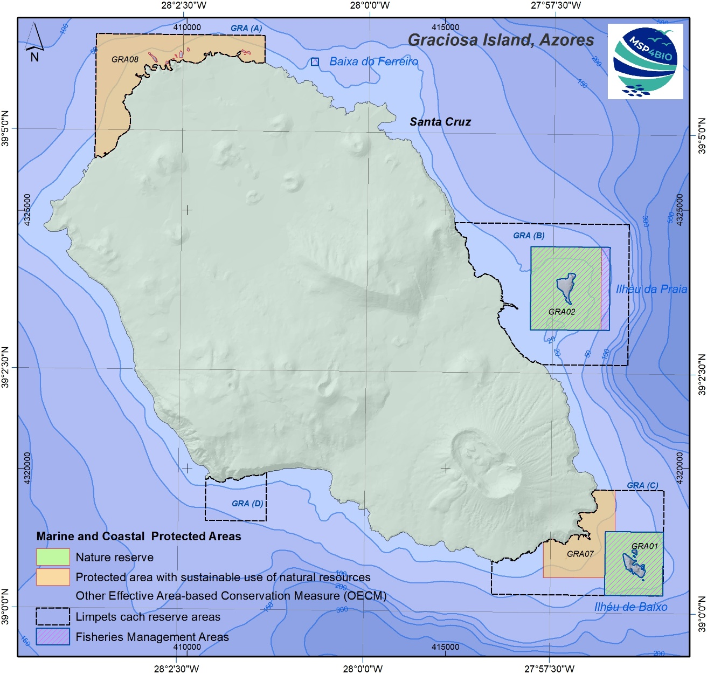

Slide 29



www.msp4bio.eu
Sign up for our Newsletter!
@MSP4BIO_project
MSP4BIO

