Slide 1
Notes:
In line with the EU’s General Data Protection Regulation (GDPR), we kindly ask participants to keep their camera on only if they consent to being recorded and included in event photos.
If you prefer not to be recorded, please feel free to turn your camera off.
Additionally, feel free to drop your questions in the Q&A section and vote for those you find most interesting.
Thank you for your cooperation and engagement!

Slide 2
MSP4BIO
Improved Science-Based Maritime Spatial Planning to Safeguard and Restore Biodiversity in a coherent European MPA network
Webinar: How Can Maritime Spatial Planning Help Achieve Europe’s 30×30 Targets?
06 June 2025, online
www.msp4bio.eu
@MSP4BIO_project
MSP4BIO

Slide 5
Webinar: Key takeaways
An overview of protection and restoration measures in Europe.
Insights into barriers and opportunities for integrating biodiversity in EU MSP policies and plans.
Policy recommendations and successful factors for effectively integrating conservation measures within MSP across various governance levels and ecosystems.

Slide 6
MSP4BIO
Improved Science-Based Maritime Spatial Planning to Safeguard and Restore Biodiversity in a coherent European MPA network
Ivana Stojanovic, s.Pro, Project Coordinator
Webinar: How Can Maritime Spatial Planning Help Achieve Europe’s 30×30 Targets?
6 June 2025, online
www.msp4bio.eu
@MSP4BIO_project
MSP4BIO

Slide 7
MSP4BIO: KEY FACTS
6 TEST SITES
4 PILLARS
3 SISTER PROJECTS
DURATION
August 2022-July 2025
BUDGET
3,490,500 EUR
18 PARTNERS

Slide 8
MSP4BIO: MAIN GOAL
Convention on Biological Diversity (CBD) Post-2020 Global Biodiversity Framework
EU Biodiversity Strategy (EUBS) 2030
EU Green Deal

Slide 9
MSP4BIO: PILLARS
Pillar 1 - Environment: MSP4BIO will improve the knowledge base and criteria for better prioritization of areas for biodiversity restoration and conservation.
Pillar 2 - Policy: MSP4BIO develops solutions that support coherent policy implementation and effective mainstreaming of biodiversity into relevant policies.
Pillar 3 - Socio-economic: Develops a framework for a more integrated and flexible strategic and spatial integration between MSP and MPAs, validated in 6 test sites in all 5 European Sea Basins.
Pillar 4 – Integration: MSP4BIO integrates the socio-economic considerations in MPA prioritization and management.

Slide 10
MSP4BIO: OBJECTIVES
SO1. Improve the science base for the description of MPAs and EBSAs and, identification of new, restoration, enlargement and management of existing MPAs.
SO2. Develop and demonstrate a novel flexible management framework that integrates ecological and socio- economic dimensions for the prioritization of strategic and spatial conservation-management measures.
SO3. Strengthen the role of MSP as an integrative framework to support the coherent implementation of relevant policies (MSFD, WFD, MSPD, BHD, Common Fisheries Policy (CFP), etc.) as well as the EUBS2030 and the CBD post-2020.
SO4. Improved biodiversity and natural capital integration into public and business decision-making at all levels for the protection and restoration of ecosystems and their services.

Slide 11
BALTIC SEA
Transboundary sea basin
Ecosystem under multiple human-induced pressures
Need for more MPAs designated areas to achieve the regional goal
Need for a coordinated plan for human activities
BLACK SEA
Cross-border area: 2 countries
Diversity of marine domains
MPAs Support huge biodiversity and ecosystem services
MPAs fragmented and do not have operational management
ATLANTIC 1 – GULF OF CADIZ
Hot spots with special needs for MSP and MPA
Need for improvement of MSP and stronger consideration of sea-land interactions in planning
Human activities threaten MPAs in their vicinity
NORTH SEA – BELGIAN AREA
Well studied and monitored area
Need for spatial strategy for pelagic biodiversity conservation
Need for geographical biodiversity assessments units
NW-MED
Governance complexity as area is shared between 3 countries
Large spatial scale
Diversity of marine domains
Multiplicity of human activities
ATLANTIC 2 – AZORES (Graciosa Island)
Rich habitat diversity – knowledge gaps in offshore and coastal areas
Need for strategies to enlarge MPA network and for “fully protected areas”
No MSP approved yet

Slide 12

MSP4BIO: KEY RESULTS
MPA/MSP strategic integration framework
Policy coherence solutions to strengthen MSPs compatibility with the new biodiversity policy requirements
EU-wide overview of biodiversity data availability
Integrated modular management framework allowing for better integration of biodiversity considerations in MSP, wider participation and adaptation
Ecological Toolkit ensuring better integration of data in decision making (improved DSTs)
Participatory development of integrated trade-off scenarios. Good management practices for blue economy sectors.
6 demonstrators at different governance levels producing site specific solutions

Slide 13
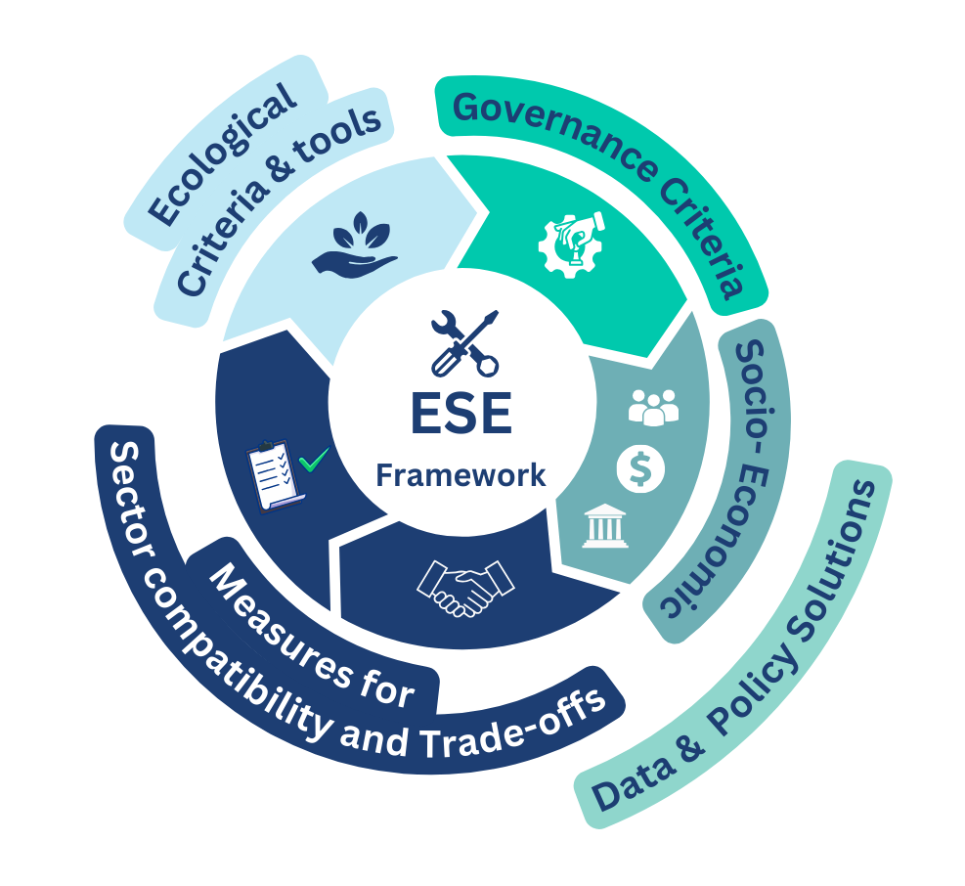
MSP4BIO ESE Framework – biodiversity mainstreaming in MSP

Slide 14

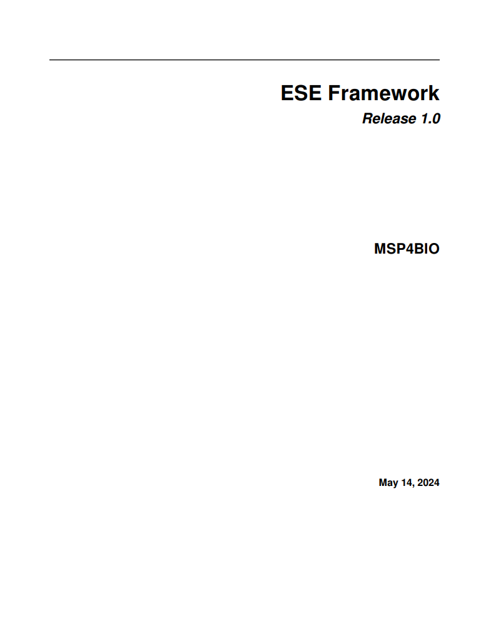
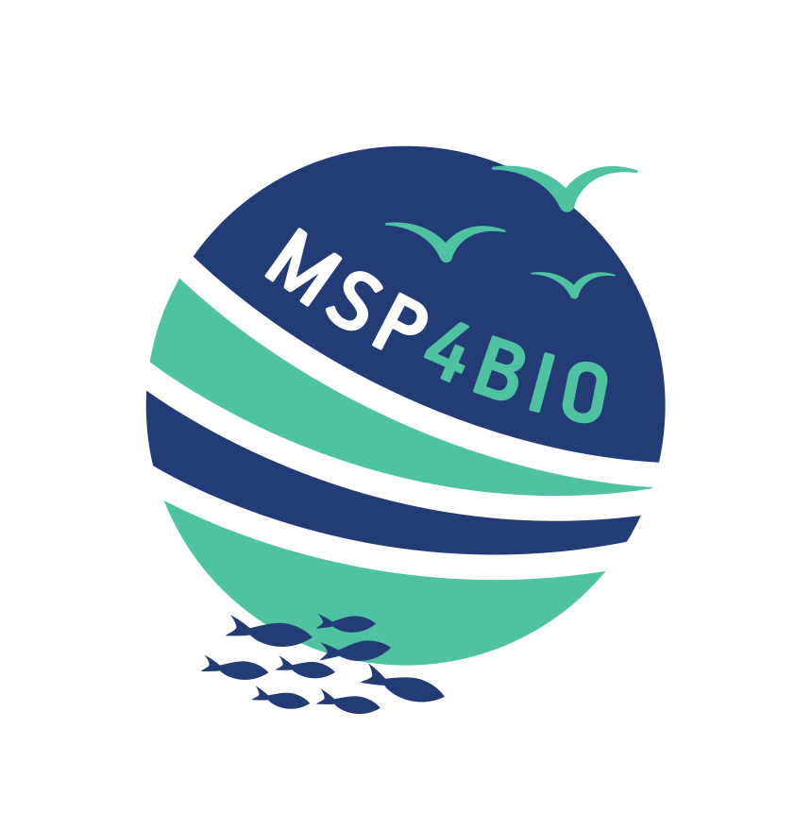

MSP4BIO – ESE Framework online tool/document
PDF file
https://ese.tools4msp.eu

Slide 15
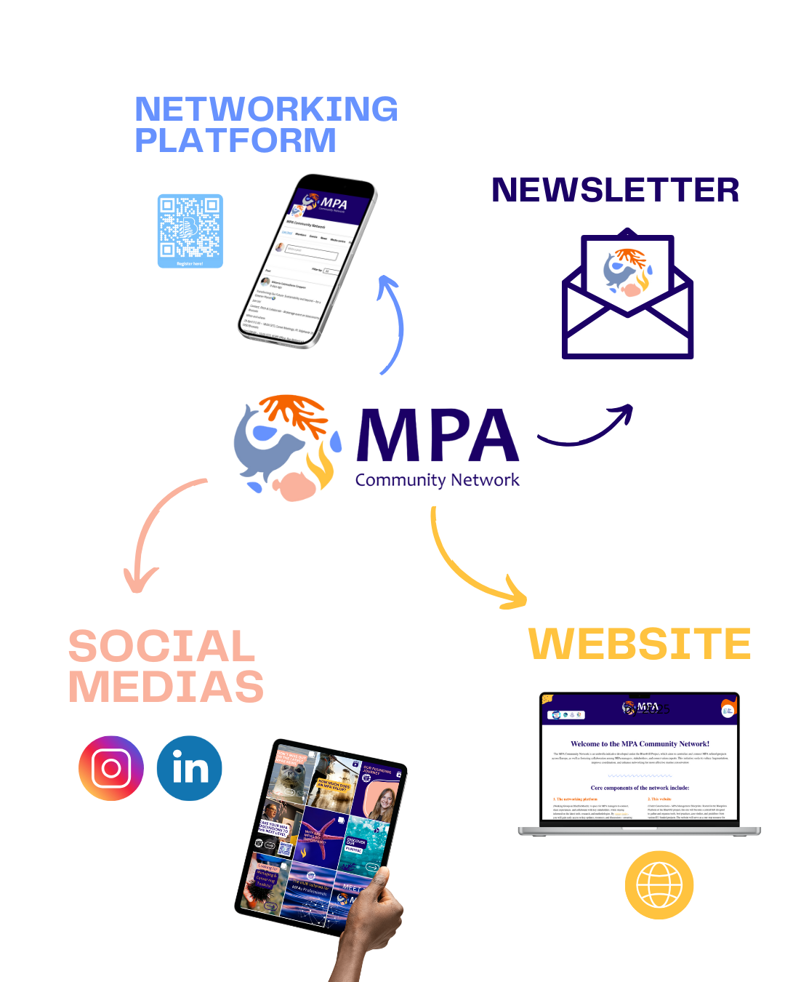

MSP4BIO results: exploitation and legacy

Slide 16
MSP4BIO joined the MPA Community Network! Interested? Join us!

Slide 17



MSP4BIO
FINAL EVENT
Date: 2nd - 4th of July 2025
Location: CNR-ISMAR Headquarter, Venice, Italy.
REGISTRATION IS OPEN
WWW.MSP4BIO.EU

Slide 18

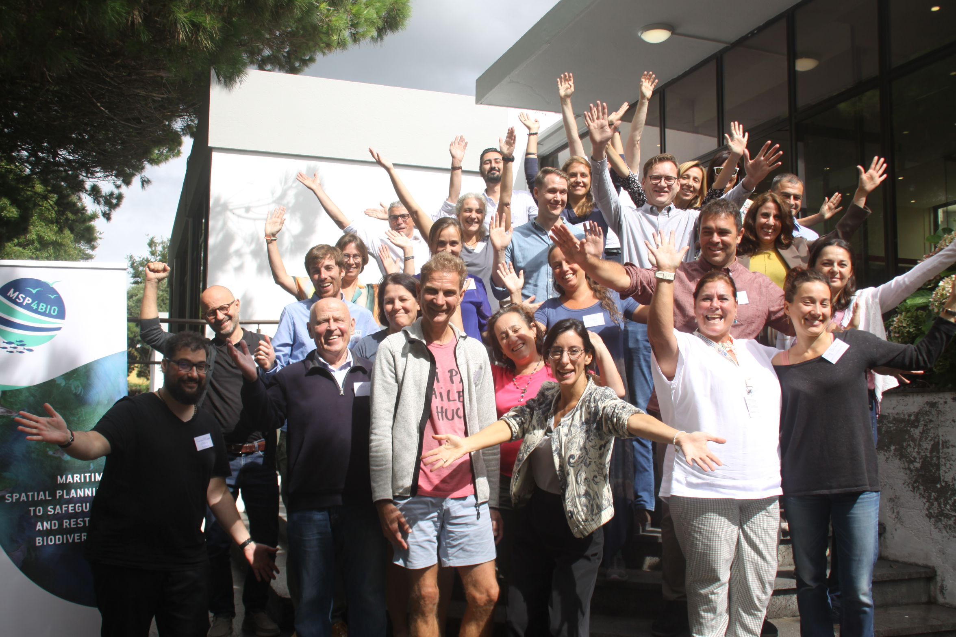















MSP4BIO: PARTNERS

Slide 19



www.msp4bio.eu
Sign up for our Newsletter!
@MSP4BIO_project
MSP4BIO

Slide 20
MSP4BIO
Area-based conservation measures
Where do we stand today? A snapshot of progress and challenges
Martina Bocci, CNR Consultant
Webinar: How Can Maritime Spatial Planning Help Achieve Europe’s 30×30 Targets?
6 June 2025, online
www.msp4bio.eu
@MSP4BIO_project
MSP4BIO

Slide 21
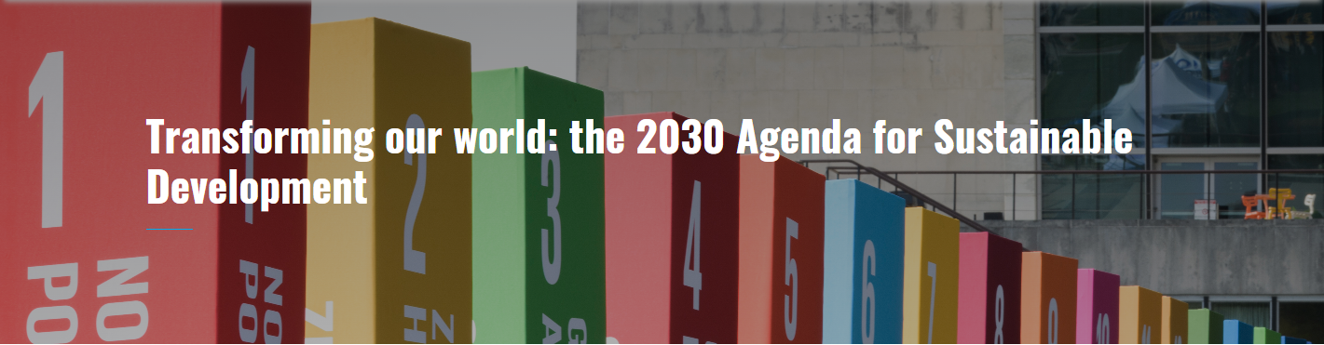


Halting biodiversity crisis: conservation targets
17 Sustainable Development Goals (SDGs) and 169 targets
SDG 14 (Life below water): conservation and sustainable use of oceans, seas, and marine resources.
Key priorities: reduce marine pollution, protect coastal and marine ecosystems, combat ocean acidification, end overfishing and illegal fishing
Conserve at least 10% of marine and coastal areas by 2030.
2015
4 global goals for 2050
23 action-oriented global targets for urgent action by 2030
TARGET 1: Plan and Manage all Areas To Reduce Biodiversity Loss
TARGET 2: Restore 30% of all Degraded Ecosystems
TARGET 3: Conserve 30% of Land, Waters and Seas
2022
Notes:
The 2030 Agenda for Sustainable Development is a universal call for action to end poverty, protect the planet, and ensure that all people enjoy peace and prosperity. It identifies the eradication of poverty in all its forms and dimensions as the greatest global challenge and an essential requirement for sustainable development. The Agenda is founded on five core pillars: People, Planet, Prosperity, Peace, and Partnership. It is designed to be implemented by all countries and stakeholders through collaborative partnerships, with a commitment to leaving no one behind.
Comprising 17 Sustainable Development Goals (SDGs) and 169 targets, the Agenda builds on the achievements of the Millennium Development Goals (MDGs) and aims to complete what they did not. It seeks to realize the human rights of all, achieve gender equality, and empower all women and girls.
The SDGs are integrated and indivisible, balancing the economic, social, and environmental dimensions of sustainable development, and they represent a bold and transformative roadmap towards a more sustainable and resilient future.
SDG 14 (Life below water) focuses on the conservation and sustainable use of oceans, seas, and marine resources. It recognizes the critical role of healthy marine ecosystems in global development and seeks to address the various threats they face. Key priorities include reducing marine pollution—especially from land-based sources such as debris and nutrient runoff—and protecting coastal and marine ecosystems through sustainable management and restoration efforts. The goal also aims to combat ocean acidification through scientific cooperation, regulate harvesting practices, end overfishing and illegal, unreported, and unregulated (IUU) fishing. At the same time, it aims towards ensuring access for small-scale artisanal fishers to marine resources and markets. SDG 14 further promotes the development of scientific knowledge, research capabilities, and the transfer of marine technology, particularly to support developing nations.
In line with international and national legislation, it called for the conservation of at least 10% of marine and coastal areas by 2020. Building on this SDG, in December 2022, Parties to the Convention on Biodiversity (CBD) agreed to conserve 30% of land and seas by 2030 , under the Kunming-Montreal Global Biodiversity Framework (KMGBF). This is further supported with the 2022 One Ocean Summit commitments, signed by at least 84 countries.
SDG14 targets and the related KMGBF framework play a crucial role in advancing MSP implementation globally. Their clear objectives, such as promoting ecosystem-based approaches to marine management (SDG 14.2) and explicitly mandating biodiversity-inclusive MSP (KMGBF, Target 1), reinforce international legal frameworks. In particular, they strengthen commitments under the United Nations Convention on the Law of the Sea (UNCLOS), for the conservation and sustainable use of marine environments, ensuring a more integrated and resilient approach to ocean governance.

Slide 22

Halting biodiversity crisis: conservation targets
Legally protect a minimum of 30 % of the EU’s land area and 30 % of the EU’s Seas and integrate ecological corridors, as part of a true Trans-European Nature Network.
Strictly protect at least a third of the EU’s protected areas, including all remaining EU primary and old-growth forests.
Effectively manage all protected areas, define clear conservation objectives and measures, and monitor them appropriately.
2020

Slide 23
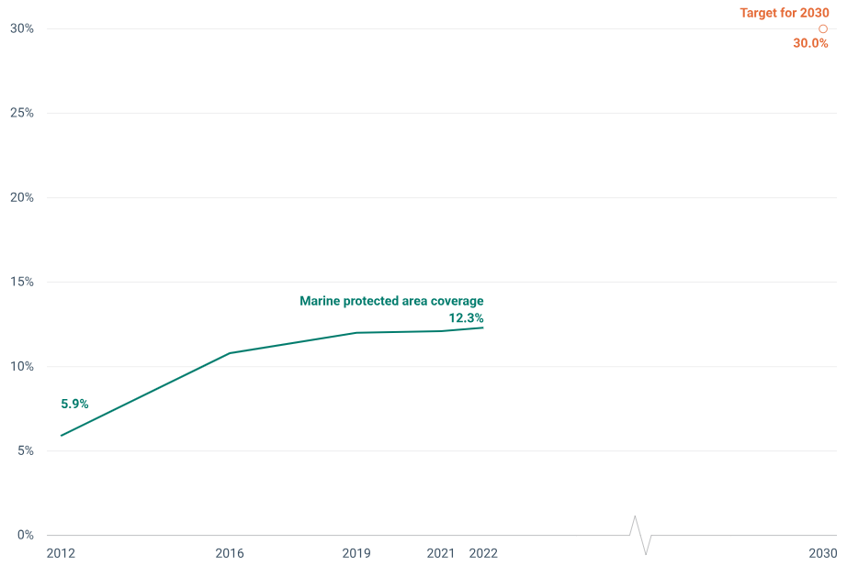
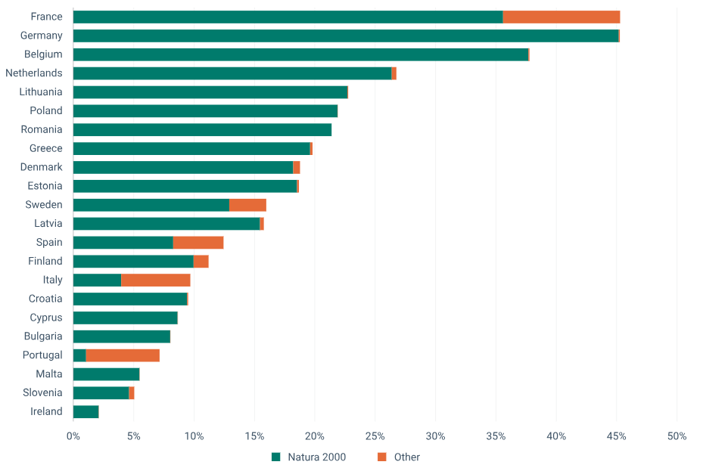
Marine protected areas in Europe's seas
Source: EEA, 2024
Notes:
Over the last decade, the total area covered by MPAs in the EU has increased from 5.9% in 2012 to 12.3% in 2023
This is the result of both the expansion of the Natura 2000 network (a network of protected areas designated under the EU nature directives) and protected areas established through complementary national designations, as well as protected areas designated under the Regional Seas Conventions (RSC), namely Barcelona Convention, HELCOM & OSPAR.
Despite the progress, the current extent of sea areas under protection remains critically below the levels required to meet the EU Biodiversity Strategy for 2030 goals. The overall number and extension of marine protected areas will need to increase at a significantly faster rate than in the past decade if the EU is to achieve the 30% target by 2030 (EEA, 2023).

Slide 24
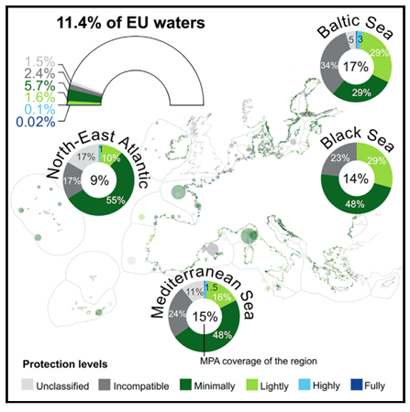
Lack of effective protection
Low level of protection
Missing or unapplied management plans
Management measures weakly or not implemented
Lack of resources
0.2% of MPAs fully or highly protected
86% of MPAs area show low protection levels or incompatibility with conservation
Minimal protection is widespread across member states, regions, and MPA features
Source: Aminian-Biquet et al., 2024
Notes:
Marine protected areas encompass numerous levels of protection and many different combinations of uses that are allowed or not allowed, with consequent impacts on biodiversity.
In addition, effective management represents a major issue.
In fact, although more than 10% of the EU seas is now designated as MPAs, most of these areas are poorly or not managed, with missing management plans/planning schemes and/or management measures poorly or not implemented.
Moreover, there is a general lack of resources for managing monitoring and enforcement in MPAs with the consequence of little effective protection in place.

Slide 25
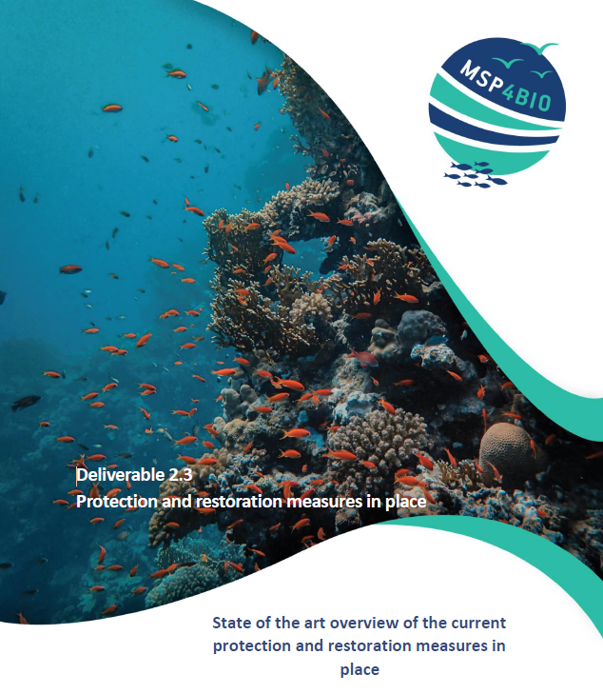

A state-of-art overview
Main categories and main features of Marine Protected Areas currently applied to protect marine ecosystems and species, considering international, European and national level measures
Examples of Other Effective area-based Conservation Measures (OECMs)
(Examples of restoration measures)

Slide 26


Our approach
A screening was performed considering some test-site countries (both EU and non-EU) across the sea basins
Baltic Sea: all countries
North Sea: Belgium, Denmark, Germany, Scotland
North-East Atlantic: France, Portugal
Mediterranean Sea: Albania, Bosnia-Herzegovina, Croatia, France, Italy, Montenegro, Slovenia, Spain
Black Sea: Bulgaria, Romania
Typologies of designations in each country
In-depth analysis of some illustrative cases of MPAs and OECMs
Interviews were undertaken to understand details about the designation and implementation process, identify limitations, good practices, trade-offs and barriers.

Slide 27
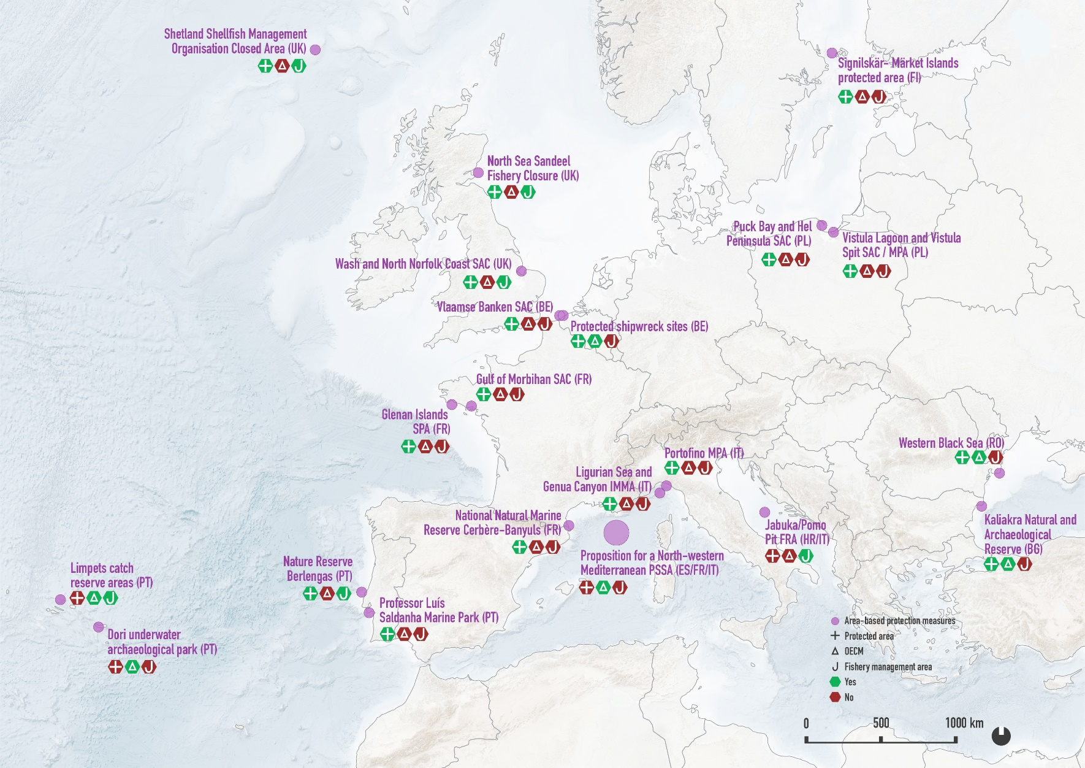
Illustrative cases
23 sites
17 protected natural areas
6 fishery management areas
6 OECMs, including PSSA and protection of UCH

Slide 28

Features of MPAs
Designation type
Designation level (subnational, national, regional, European or international level)
Type of area (coastal, offshore, deep sea)
Uses and human activities (ex MSFD 2017/845 – Tab. 2)
Anthropogenic pressures (ex MSFD 2017/845 – Tab. 2a)
Ecological criteria used for designation
Management measures: availability of a management plan for the area was checked and measures described
Trade-offs between sea uses and marine protection
Coexistence and multi-use of the sea: description of practices.

Slide 29
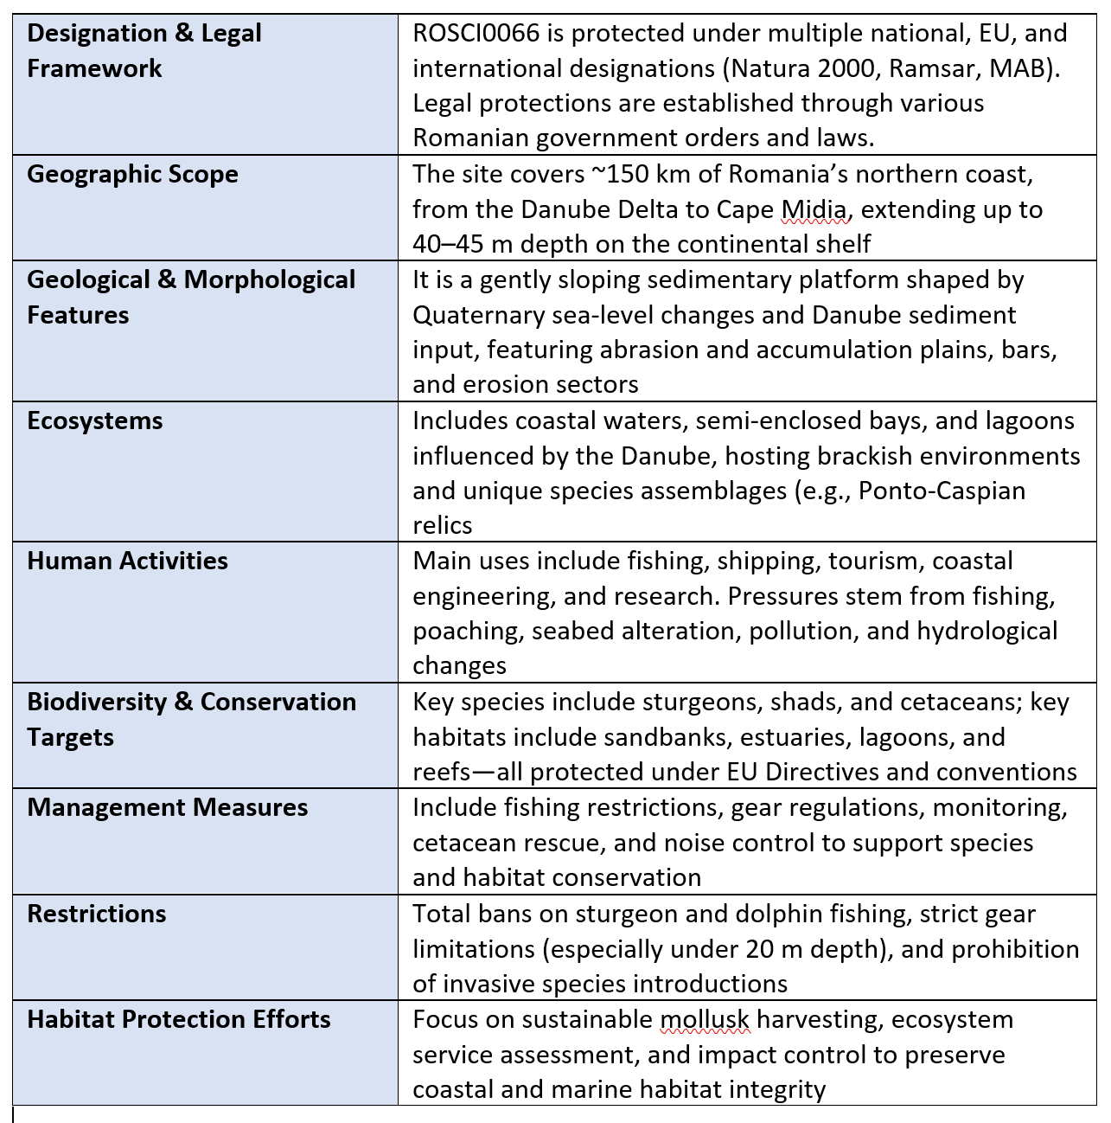
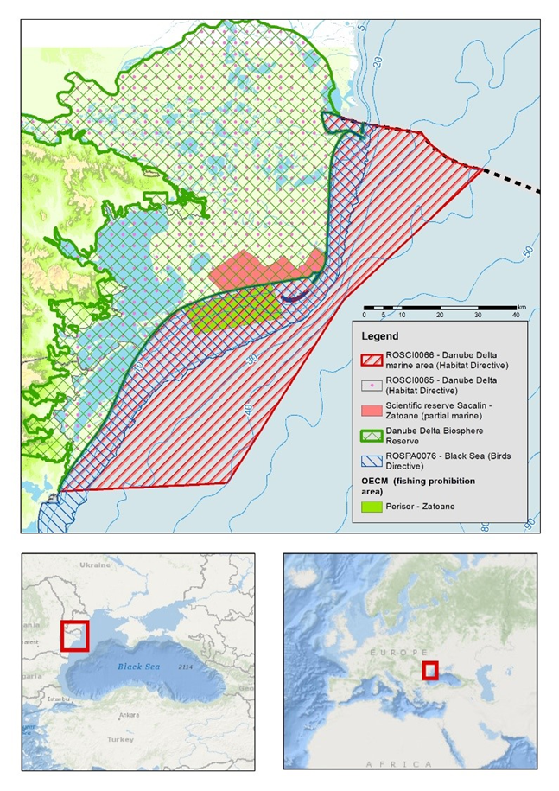
Example of results
Danube Delta marine area (RO)
23 detailed fact sheets available!

Slide 30
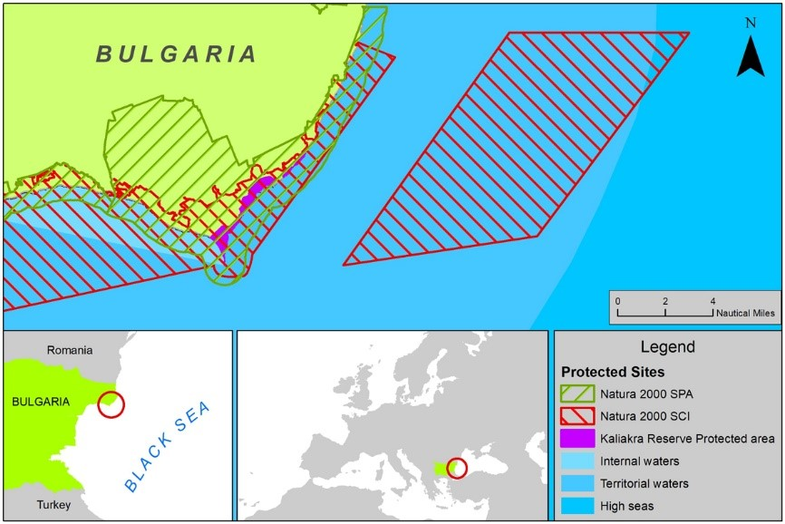
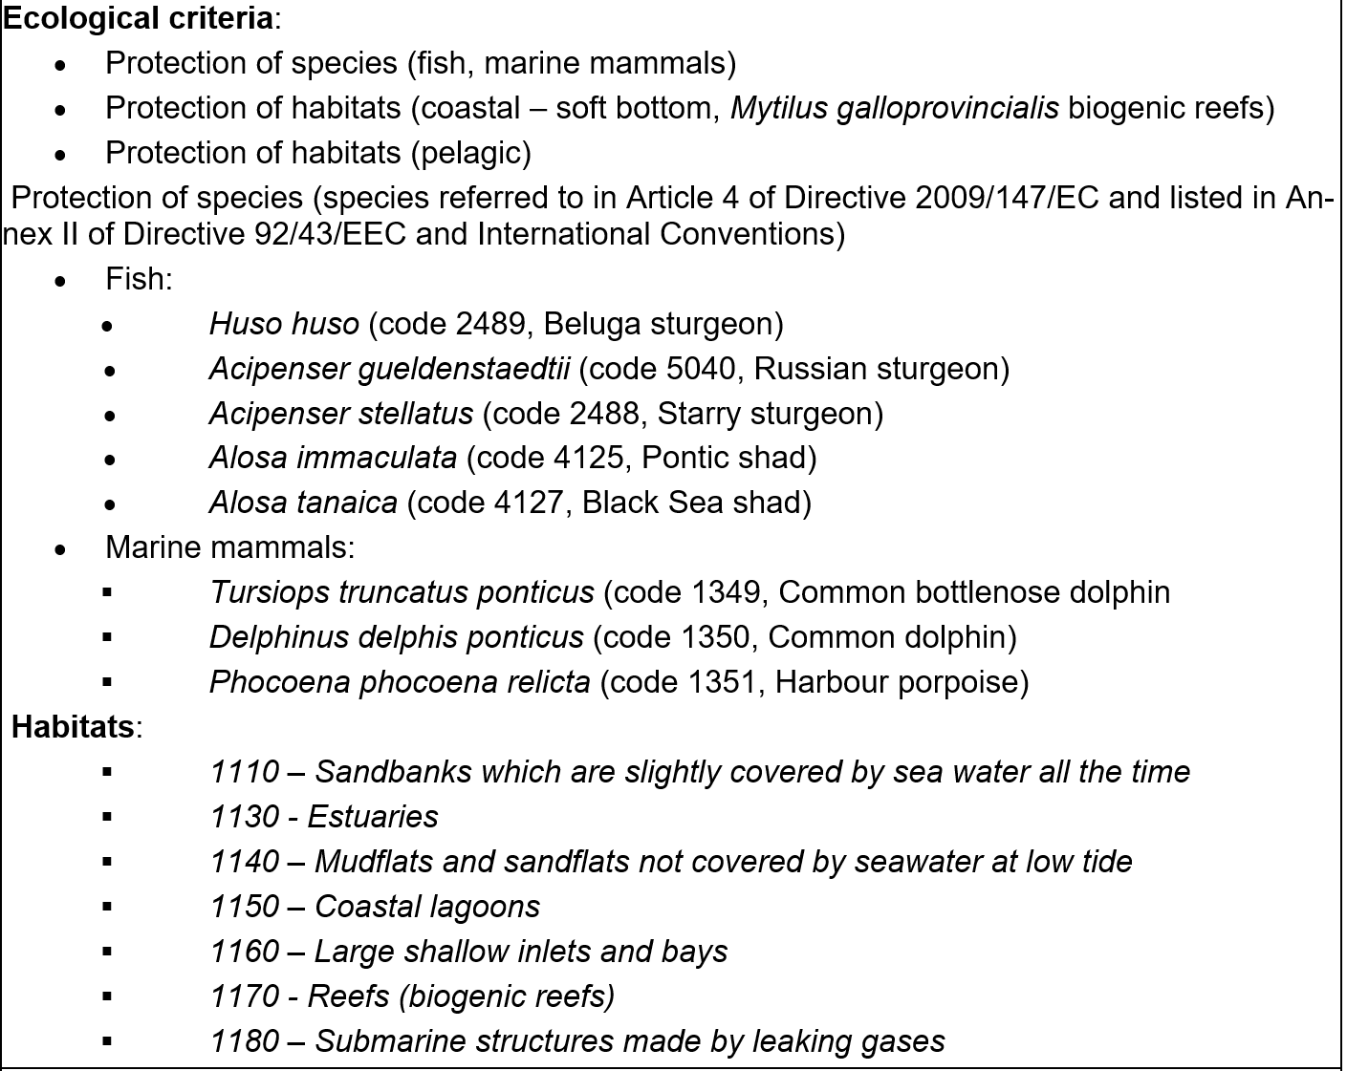
Ecological criteria prioritized for conservation
Kaliakra Natural Reserve/protected area (BG)
Ecological conservation priorities vary significantly across sea basins and countries.
Baltic Sea MPAs (e.g., Finland, Poland) focus on protection of species, migration routes, and reproduction areas.
North Sea MPAs (UK, Belgium) protect fish, seabirds, and diverse marine habitats.
North-Eastern Atlantic MPAs (France, Portugal) emphasize the conservation of birds, fish, algae, and invertebrates.
Mediterranean MPAs (Italy, France, Croatia) prioritise marine mammals, endangered species, and deep-sea habitats.
Black Sea MPAs (Bulgaria, Romania) safeguard coastal habitats and a wide range of marine species.

Slide 31
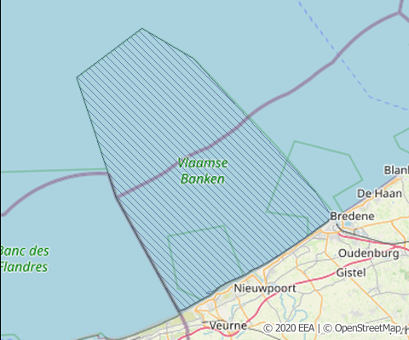
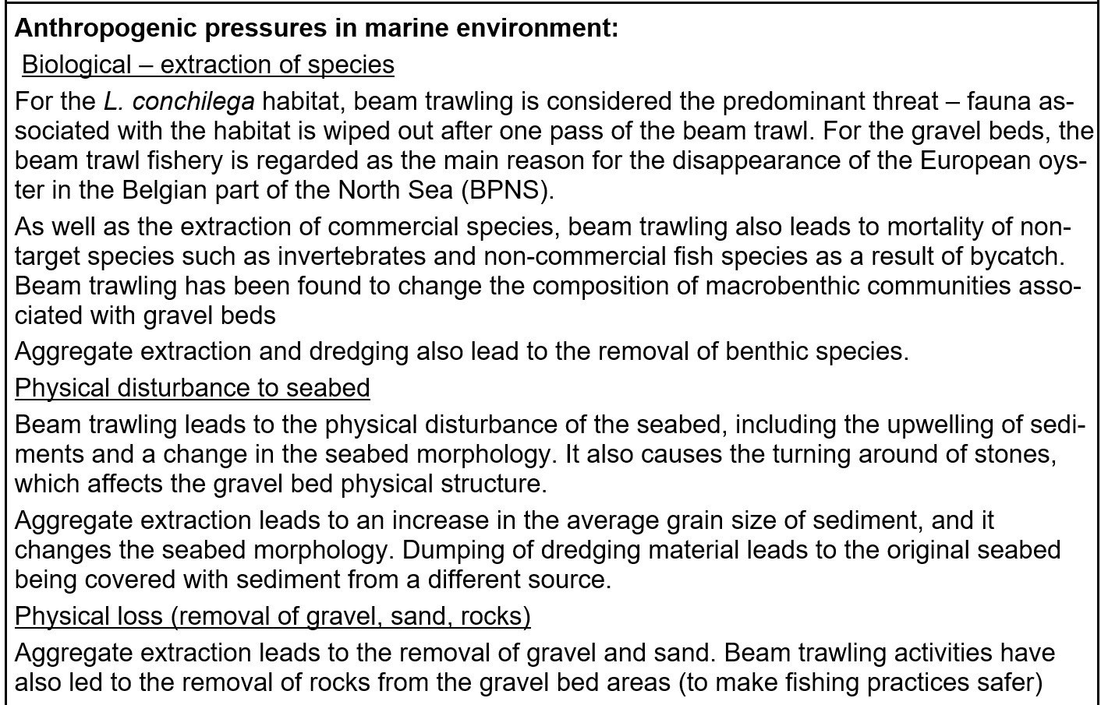
Pressures targeted by conservation measures
Vlaamse Banken SAC (BE)
MPAs across sea basins face a variety of anthropogenic pressures.
Baltic Sea sites (Finland, Poland) are impacted by nutrient and contaminant input, species disturbance, and physical seabed disruption.
North Sea sites (UK, Belgium) face pressures from species extraction, seabed disturbance, physical loss, and marine litter.
North-Eastern Atlantic MPAs (France, Portugal) experience multiple pressures, including litter, sound pollution, nutrient input, and species extraction.
Mediterranean and Black Sea sites (Italy, Bulgaria, Romania) are affected by species extraction, pollutants, noise, and changes in hydrology.

Slide 32
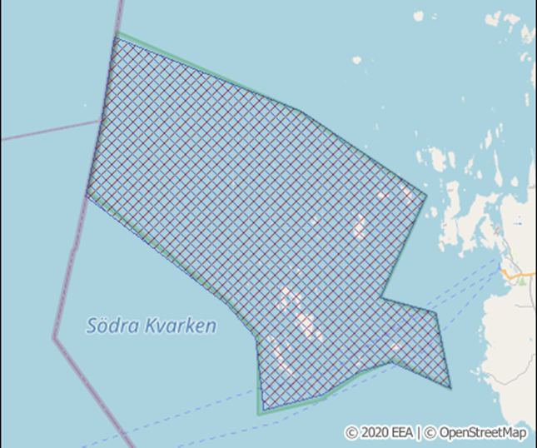
Trade-offs between conservation and human activities
Protected area of Signilskär- Märket Islands (FI)
In Signilskär-Märket Islands (FI) and Cerbère-Banyuls (FR), to allow activities like fishing, hunting, scuba diving, and boat anchoring.
In the North-western North Sea (UK), stakeholders accepted protection due to shared recognition of ecosystem impacts.
Other North Sea sites (e.g. SSMO, Eastern IFCA) benefited from early stakeholder engagement, leading to smoother acceptance.
Tips:
Limited protection measures or lack of enforcement led to passive stakeholder acceptance, not genuine negotiation.
Need for true engagement and effective protection measures, rather than symbolic or weak designations.
Designation type: NATURA 2000, HELCOM MPA, Ramsar - Designated and managed

Slide 33
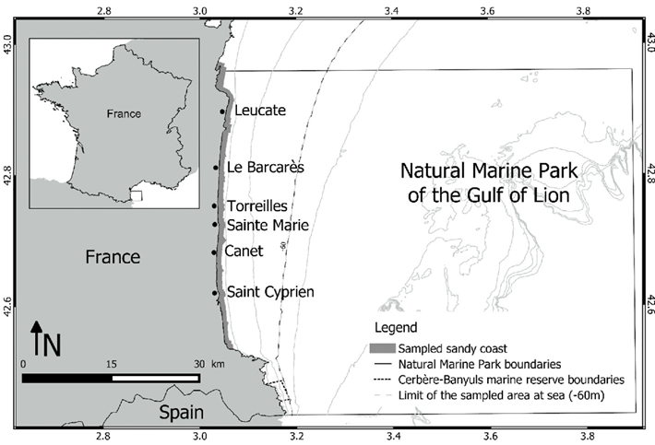
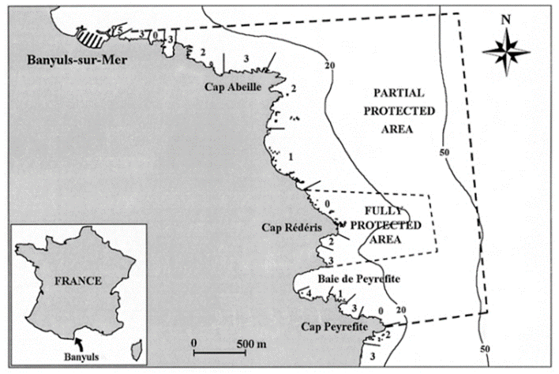
Learning tips
Natural Marine Park of the Gulf of Lion and the National Natural Marine Reserve Cerbère-Banyuls (FR)
A mix of top-down and bottom-up approaches can be successful
In France, the Cerbère-Banyuls Reserve was established top-down, while the Gulf of Lion Marine Park developed restrictions progressively through local management. Improved cooperation between their separate management bodies has led to better coordination, monitoring, and planning.

Slide 34
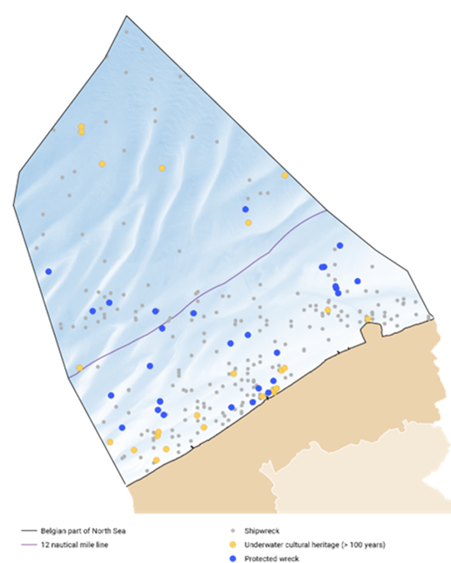
Learning tips
Fisheries restriction measures around protected wreck sites (BE)
Protection of ecological and cultural values (Underwater Cultural Heritage) can reinforce one another
Examples: the protected shipwreck sites in the Belgian sea, the Dori underwater archaeological park in the Azores, the Kaliakra Natural Reserve/protected area in Bulgaria.
Designation type:
Restrictive measures related to fisheries, anchorage and construction works in the context of the protection of shipwreck sites.

Slide 35
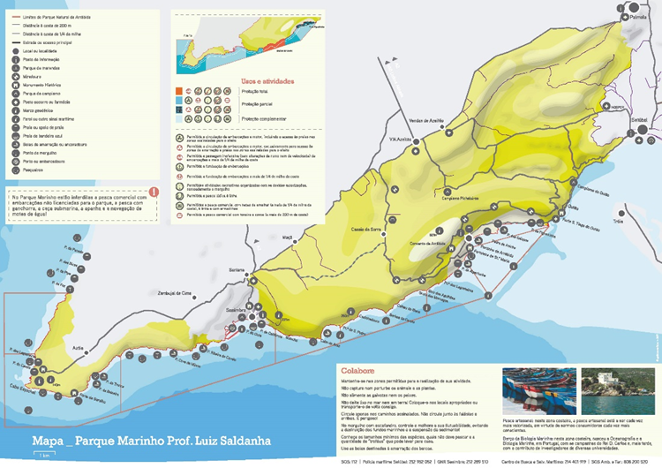
Learning tips
Marine Park Professor Luis Saldanha / Arrabida Natural Park (PT)
Integration of different area-based marine protection tools can help providing stronger protection
Marine parks, such as the Pelagos Agreement or OECMs like PSSAs as kind of loose protection measures, can be an opportunity to pave the way for more specific area-based measures.
Overlapping of different type of protection measures, when well-coordinated, can provide synergies and mutual reinforcement.
Examples: Parque Marinho Luís Saldanha PT, the Natural Marine Park of the Gulf of Lion + the National Natural Marine Reserve Cerbère-Banyuls (FR), the Kaliakra Natural Reserve/protected area (BG) and the Danube Delta protected area (RO).
Designation type: Nature Park. The entire Marine Park area is part of the Arrábida Natural Park, managed by the Institute for Nature Conservation and Forests (ICNF), and is integrated into the European network of conservation areas - Natura 2000 Network.

Slide 36
Conclusions
Area-based conservation measures are powerful tools for biodiversity protection, but their extension should be enlarged and effectiveness strengthened
Gaps in designations: length of process, low level of protection, limited or just formal stakeholder engagement
Gaps in implementation: effective management, monitoring and control, lack of resources
Opportunities: use different tools in combination, combine top-down and bottom-up approaches, ensure stakeholder understanding of conservation benefits
Protection and restoration measures are complementary and should be applied in combination: long-term perspective is needed (strategic planning accounting for future changes in the socio-economics and environment)
MSP is key to create such long-term strategic perspective to protection and restoration require.

Slide 37
Q&A Session

Slide 38
MSP4BIO
Barriers and opportunities for mainstreaming biodiversity through MSP
Insights into policy levers and barriers at EU, regional, and national levels
Päivi Haapasaari, Finnish Environment Institute (SYKE)
Webinar: How Can Maritime Spatial Planning Help Achieve Europe’s 30×30 Targets?
6 June 2025, online
www.msp4bio.eu
@MSP4BIO_project
MSP4BIO

Slide 39





BIODIVERSITY MAINSTREAMING and MSP
Challenge: mainstreaming biodiversity concern and objectives into all marine policies and practices across policy levels
Barriers and levers
Solution: MSP to enhance and expedite biodiversity mainstreaming?

Slide 40

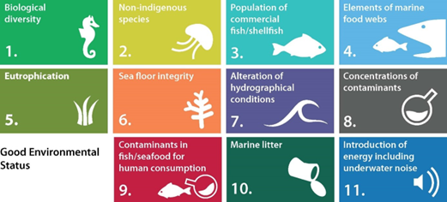

WHY MSP? KEY INSTITUTIONAL LEVERS
Covers all marine sectors, activities, conservation (e.g. MPA)
Recognized in EU policies/policy domains: EU BDS 2030, Marine Action Plan (CFP), offshore energy, maritime transport; links to MSFD
Implemented by all coastal EU member states
Support from Regional Sea Conventions

Slide 41
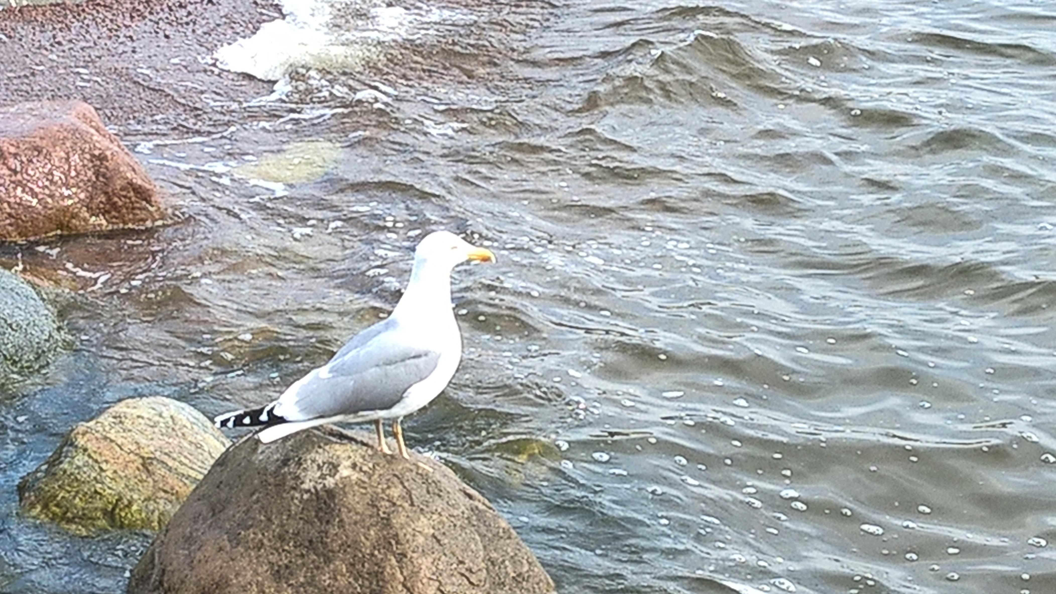


WHY MSP? KEY OPERATIONAL LEVERS
Collaborative, cross-sector, cross-disciplinary, cross-border
Links ecology and economy
Ecosystem-based Approach
Strategic Environmental Assessment (SEA)
Tool to support biodiversity communication

Slide 42
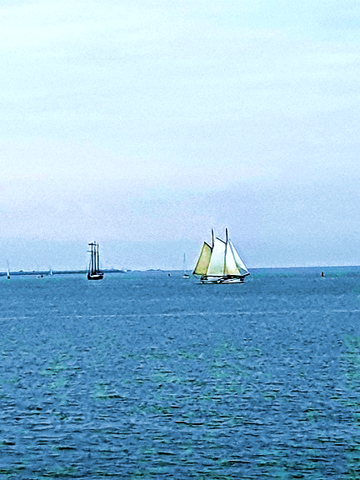

KEY BARRIER 1: UNEVEN IMPLEMENTATION
MSPD implementation varies across Member States
Role of MSP in MPA designation differs across countries
Support from Regional Sea Conventions differs
Difficulties in transboundary coordination

Slide 43
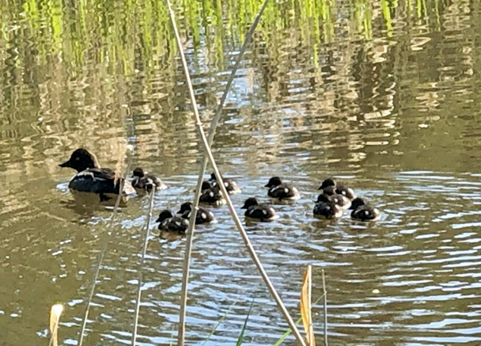


KEY BARRIER 2: WEAK COORDINATION
Policy domains siloed with poor coordination
Centralized planning hampers participation
Weak mechanisms for public participation
Lack of engagement of environmental stakeholders

Slide 44
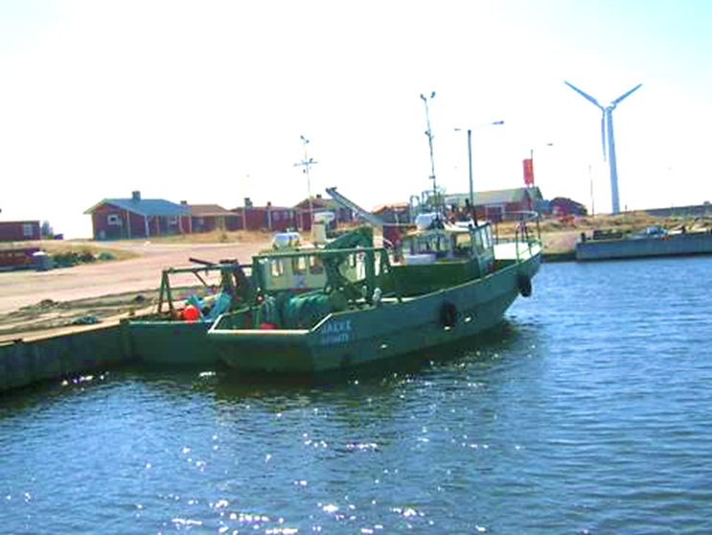
KEY BARRIER 3: CONCEPTUAL & TECHNICAL GAPS
Ecosystem-based approach vague and inconsistently applied
Role and missing thresholds of GES
Weak links to concrete biodiversity tools and measures (e.g., MPAs)
Limited human and financial resources

Slide 45

HOW ENHANCE BIODIVERSITY OUTCOMES?
Strong policy frameworks exist; implementation often falls short!
Improve legal and policy clarity, provide guidelines
Improve coordination and stakeholder engagement
Improve integration of biodiversity tools in MSP
Thank you!

Slide 46
MSP4BIO
Lessons learned and future needs for MSP and MPA integration
A look at practical experiences in the EU, achievements, and gaps in implementation
Helena Maria Gregório Pina Calado, University of the Azores
Webinar: How Can Maritime Spatial Planning Help Achieve Europe’s 30×30 Targets?
6 June 2025, online
www.msp4bio.eu
@MSP4BIO_project
MSP4BIO

Slide 47

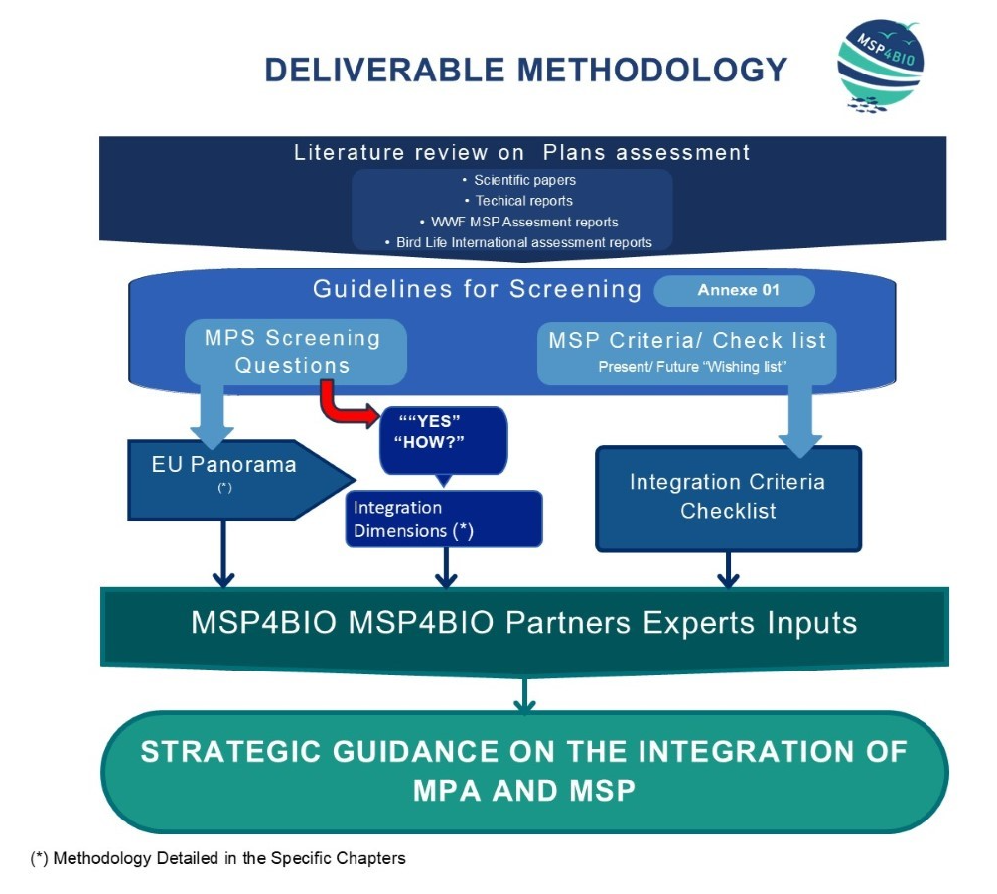


This project is funded by the European Union. The content of this presentation are the sole responsibility of the author(s) and do not necessarily reflect the views of the European Union
This project is funded by the European Union. The content of this presentation are the sole responsibility of the author(s) and do not necessarily reflect the views of the European Union

Slide 48
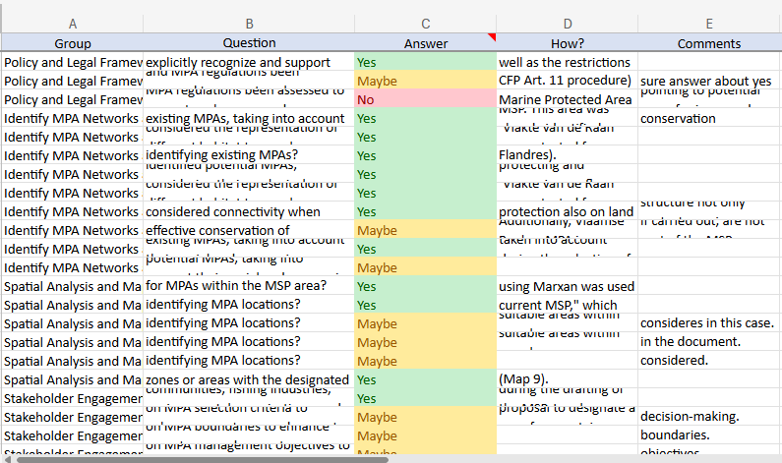
Screening MSP Plans compilation
This project is funded by the European Union. The content of this presentation are the sole responsibility of the author(s) and do not necessarily reflect the views of the European Union
This project is funded by the European Union. The content of this presentation are the sole responsibility of the author(s) and do not necessarily reflect the views of the European Union

Slide 49








Key Levels
Level 1
Conservation/MPA is the driver for MSP
Level 2
Conservation/MPA fully integrated into MSP across sectors
Level 3
Conservation/MPA integrated through SEA or Environmental Spatial Strategies
Level 4
Conservation/MPA is a layer/sector in MSP

Slide 50
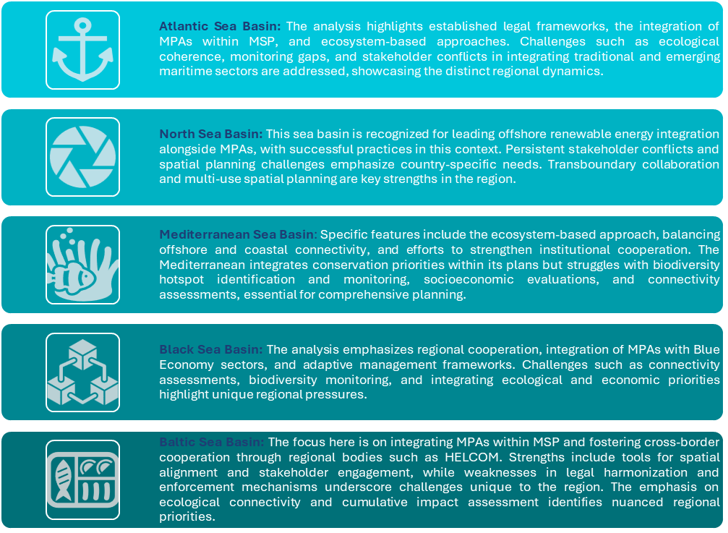

This project is funded by the European Union. The content of this presentation are the sole responsibility of the author(s) and do not necessarily reflect the views of the European Union

Slide 51
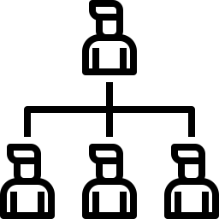





Major Gaps, Weaknesses and Threats to Integration in Each Key Level
Varying levels of coordination between MPA and MSP
Non-binding Nature of Plans
Lack of Clear Guidance
Insufficient Environmental Assessments
Legal and Structural Distinctions
Stakeholder Engagement
Notes:
Conclusion:
Across the EU Member States, in some jurisdictions, there is a clear support for the establishment of MPAs within the frameworks of MSP, while others operate with distinct processes that exhibit varying levels of coordination. This diversity in approach underscores the complexity of marine governance across Europe.
Examples of Comprehensive Integration in various European countries include:
Germany: MSP in Germany follows the Ecosystem-Based Approach, ensuring environmental protection and integrating various sectors, though the responsibilities of MSP and MPA management are distinct.
Sweden: MSP regulatory frameworks directly support MPA establishment, and areas designated for nature conservation are included in MSP planning.
Examples of Limited Integration in various European countries include:
Denmark: The legal framework governing MSP has limited support for MPAs, showing unresolved conflicts and gaps in integration.
Italy: MSP does not explicitly support MPAs, and conflicts between MSP and MPA regulations remain unaddressed within national policy.
There are several key challenges in achieving comprehensive integration between Marine MPAs in various European countries.
Legal and Structural Distinctions: Many countries have distinct legal frameworks for MSP and MPAs, leading to conflicts and contradictions during their planning processes. For instance, as e.g. while Estonia has structured similarities between MSP and MPA processes, they remain legally separate, thus giving room to contradiction.
Stakeholder Engagement: Engaging relevant stakeholders in the integration process is crucial yet often insufficient. In Poland, for example, although stakeholder involvement in developing MPA management plans is mandated, this occurs outside the MSP framework, causing disconnections.
Lack of Clear Guidance: In countries like Denmark, the existing MSP legal frameworks provide limited guidance on incorporating MPAs, which highlights the need for better coordination.
Non-binding Nature of Plans: Some MSP initiatives, such as those in Finland, have non-binding legal status, which may hamper effective enforcement and integration with MPA management.
Insufficient Environmental Assessments: Implementation of ecosystem-based approaches varies, and the lack of thorough EIA can impede effective integration, as seen in some limitations of the German MSP process.

Slide 52






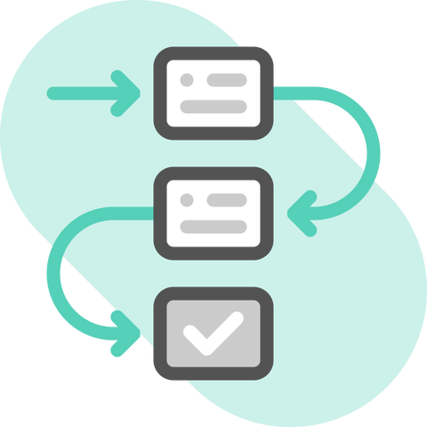




Main outcomes
Role of Strategic Environmental Assessment (SEA)
Criteria for Integration
Criteria and Future Relevance
Key Criteria by Region
Recommendations from Best Practices
Recommendations by Integration Level
Strategic Guidance for Integration
EU Sea Basin Analysis
Levels of Integration
Variation in Integration Approaches
Identified Gaps and Threats

Slide 53
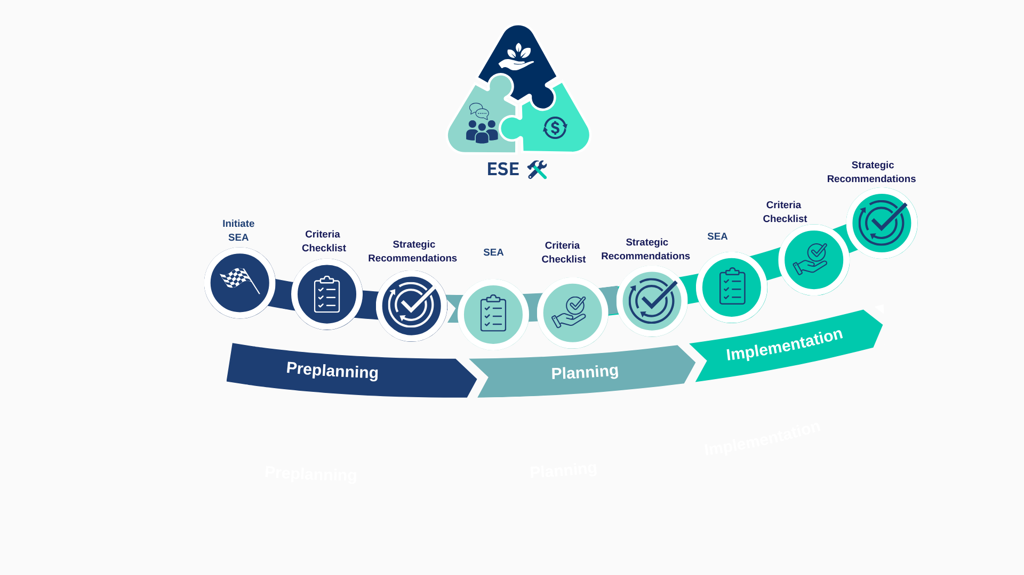
A Model for MPAs integration into MSP
This project is funded by the European Union. The content of this presentation are the sole responsibility of the author(s) and do not necessarily reflect the views of the European Union

Slide 54
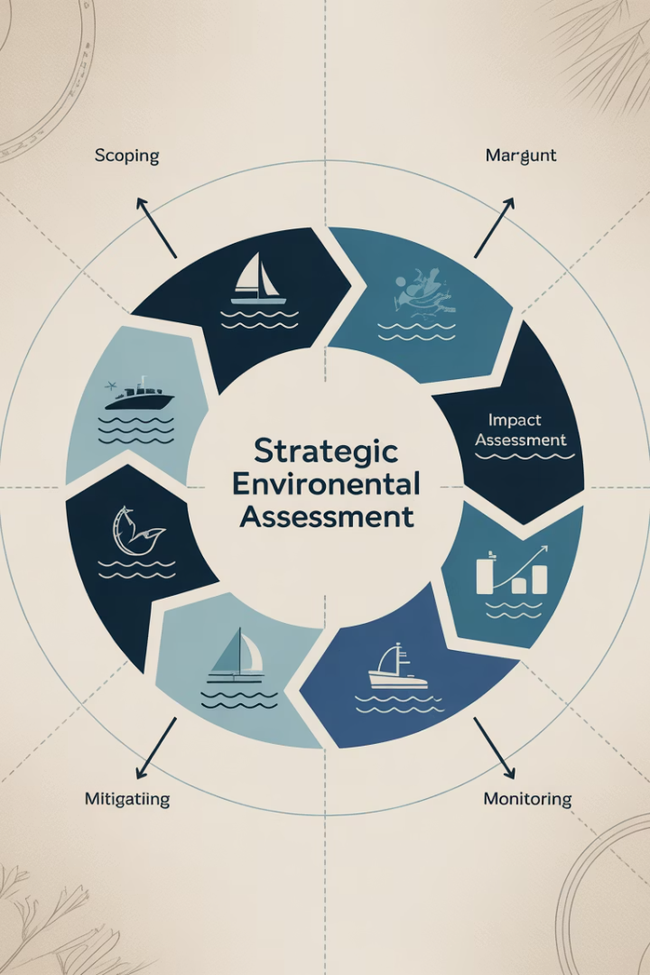





SEA
Central Role in Strategic Planning
Common Focus Areas
Mitigating Cumulative Impacts
Implementation Challenges
Sustainable Solutions Framework
Notes:
### Summary of the SEA Chapter (Maximum 5 Bullet Points)
- **SEA integrates strategic planning with EU environmental directives** such as the Marine Strategy Framework Directive (MSFD) and the SEA Directive, setting objectives for achieving Good Environmental Status (GES) and embedding ecosystem-based approaches into planning processes .
- **It offers a robust scientific foundation** for assessing cumulative environmental impacts, managing multisectoral interactions, and recommending sustainable measures for marine resource use and decision-making .
- **SEA systematically addresses cumulative and combined impacts** of multiple human activities across broad spatial and temporal scales, helping identify critical environmental risks and propose preventive or corrective strategies .
- **Implementation of SEA faces challenges**, including data gaps, methodological complexities, and institutional barriers. Overcoming these requires improved tools, integrated data, and greater stakeholder collaboration in maritime planning .
- **SEA serves as a framework for finding sustainable alternatives and mitigating negative impacts**, aiding EU member states in aligning maritime plans with long-term environmental and international sustainability commitments. Practical guidance is necessary to make sustainability operational and improve strategic decisions .
# Main Outcomes of Strategic Environmental Assessment (SEA) Integration
1. **Central Role in Strategic Planning**
SEA is pivotal in aligning strategic plans (e.g., Maritime Spatial Planning) with EU directives like the Marine Strategy Framework Directive (MSFD) and the SEA Directive, ensuring compliance with Good Environmental Status (GES) goals through ecosystem-based approaches.
2. **Mitigating Cumulative Impacts**
SEA systematically evaluates cumulative environmental and social impacts of multiple human activities across large spatial and temporal scales, enabling proactive mitigation and sustainable decision-making.
3. **Implementation Challenges**
Key barriers include insufficient environmental data, methodological limitations, and institutional fragmentation, requiring improved tools, data integration, and stakeholder collaboration to enhance effectiveness.
4. **Sustainable Solutions Framework**
SEA fosters the identification of sustainable alternatives and mitigation measures, guiding EU Member States toward long-term environmental and socio-economic goals, supported by practical implementation guidelines.
5. **Common Focus Areas**
SEA commonly addresses legal compliance, cumulative impact analysis, stakeholder participation, ecosystem uncertainties, and long-term sustainability monitoring in maritime planning processes.

Slide 55
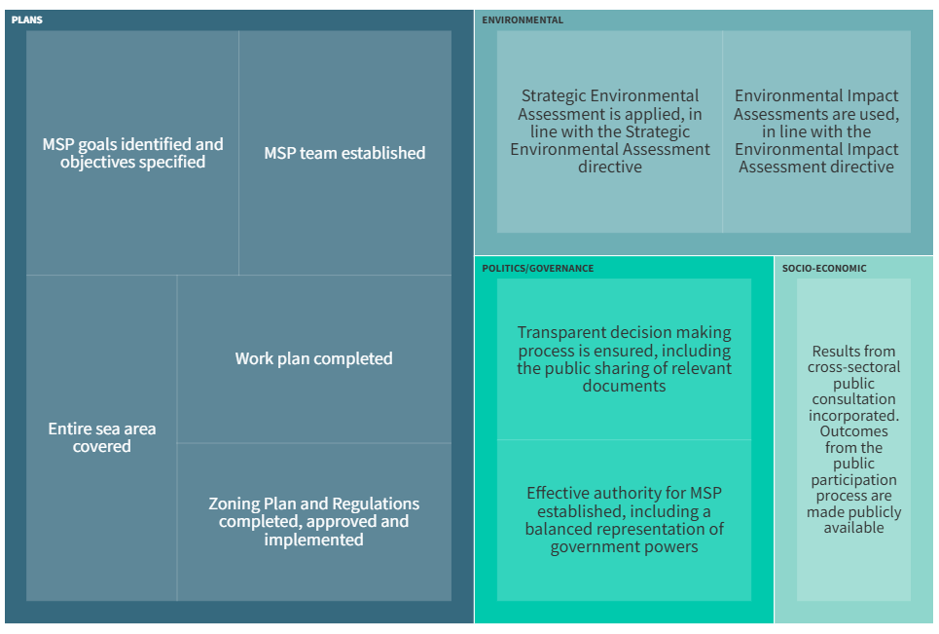

Slide 56
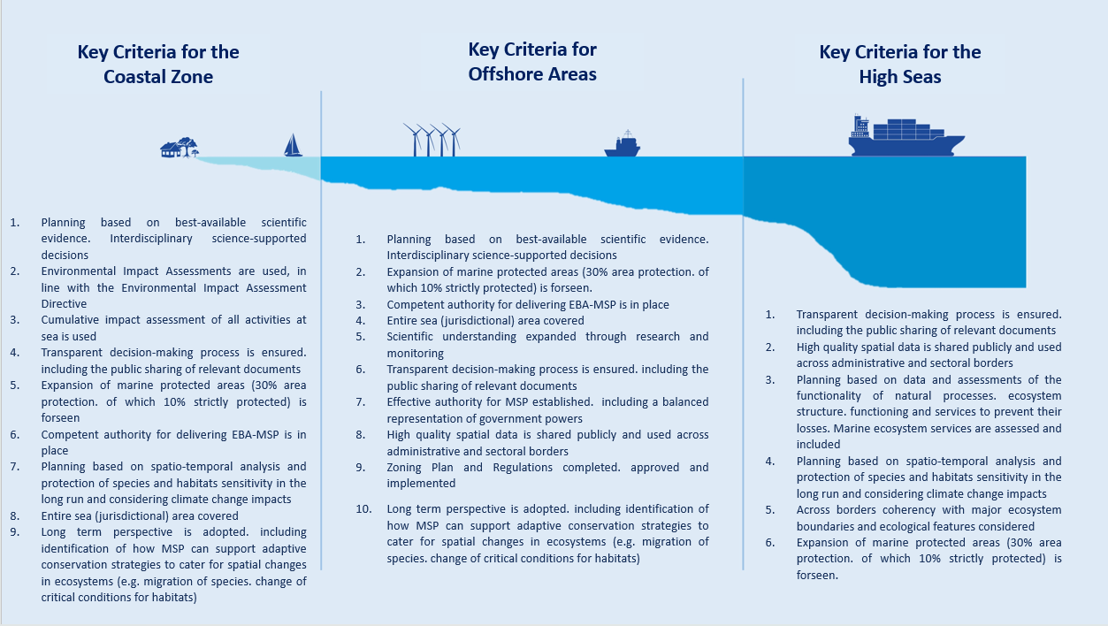

Slide 57
Strategic Guidelines for Integration
Legal Framework
Stakeholder Engagement
Adopt binding frameworks aligning MSP with MPA goals
Structured participation of communities and sectors
Monitoring & Data
Ecological Connectivity
Robust ecological data collection and enforcement
Include corridors between MPAs to prevent fragmentation
Climate Resilience
Cross-Border Coordination
Embed measures against sea level rise and acidification
Align objectives for transboundary MPAs management

Slide 58




Future needs
Structured Integration Process (legal alignment)
Balanced Conservation & Use with Inclusive Stakeholder Governance
Enhanced Monitoring and Adaptive Management
Ecological Connectivity and Climate Resilience (long-term)
Notes:
By systematically applying the criteria checklist, MPA-specific recommendations, and SEA recommendations at each stage of MSP, MPAs can be seamlessly integrated into maritime spatial plans, balancing conservation goals with sustainable use of marine resources. This approach ensures a well-structured and ecologically sound framework for managing marine environments.
The recommendations across all integration levels (Key Levels 2, 3, and 4) emphasise recurring themes, including legal alignment, stakeholder governance, enhanced monitoring, ecological connectivity, and climate resilience. These actions are necessary to foster long-term, sustainable integration between MSP and MPAs, ensuring that marine conservation objectives are not sidelined by economic activities but are adequately embedded into planning processes. This cumulative focus will strengthen institutional frameworks and advance ecosystem-based marine governance.
### Summary of Conclusion
1. **Structured Integration Process**: MPAs must be systematically integrated into MSPs using criteria checklists, MPA-specific guidelines, and SEA recommendations at every planning stage to ensure ecological and regulatory coherence.
2. **Balanced Conservation & Use**: This systematic approach balances marine conservation priorities with sustainable resource use, preventing conflicts between environmental goals and economic activities.
3. **Core Recurring Themes**: Key themes across all integration levels include legal alignment, stakeholder collaboration, adaptive monitoring, ecological connectivity, and climate resilience strategies.
4. **Long-Term Governance Benefits**: Successful integration strengthens institutional frameworks, embeds conservation into decision-making, and advances ecosystem-based governance for sustainable marine management.
### Seamless Integration of MPAs into Maritime Spatial Planning: Key Conclusions
- **Legal Alignment:** Harmonise and adapt legislative frameworks to ensure MSP and MPAs are cohesively managed and mutually supportive, with clear legal mandates and responsibilities .
- **Inclusive Stakeholder Governance:** Engage stakeholders through collaborative platforms to build consensus, resolve conflicts, and ensure transparency and inclusivity at every stage .
- **Enhanced Monitoring and Adaptive Management:** Apply robust monitoring systems, integrate data, and use adaptive management to track progress and ensure both conservation and sustainable use objectives are met .
- **Ecological Connectivity and Climate Resilience:** Prioritise ecological corridors and adopt climate adaptation measures within marine planning to foster resilient marine ecosystems and support long-term sustainability .

Slide 59
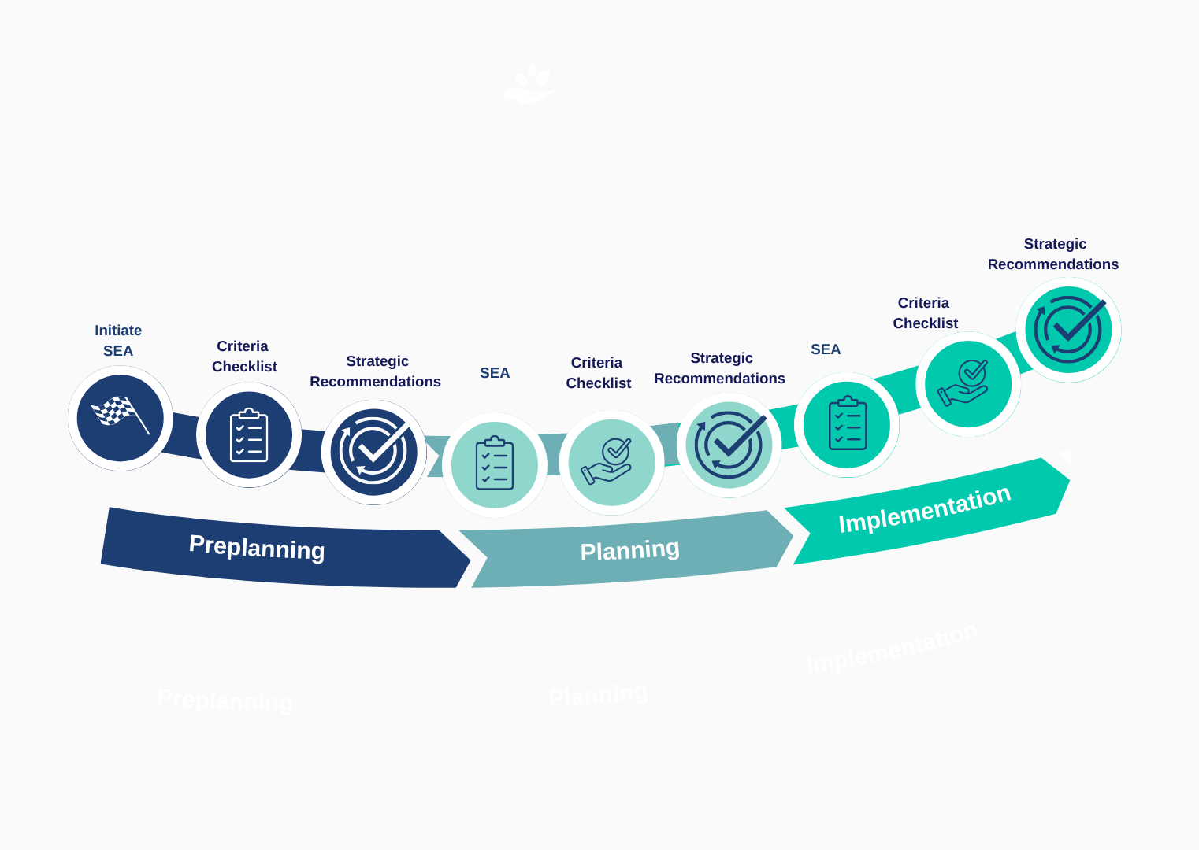
A Guide to support the integration of Marine Protected Areas into Maritime Spatial Planning
Coming soon on MSP4BIO web site!

Slide 60







www.msp4bio.eu
Register to our Newsletter!
@MSP4BIO_project
MSP4BIO
This project is funded by the European Union. The content of this presentation are the sole responsibility of the author(s) and do not necessarily reflect the views of the European Union

Slide 61
Q&A Session

Slide 62
MSP4BIO
Policy recommendations for enhancing conservation in MSPs
Key takeaways and actionable guidance for stronger conservation outcomes
Kemal Pinarbasi, HELCOM & Mauro Randone, WWF-Mediterranean
Webinar: How Can Maritime Spatial Planning Help Achieve Europe’s 30×30 Targets?
6 June 2025, online
www.msp4bio.eu
@MSP4BIO_project
MSP4BIO

Slide 63
30x30 challenge
The challenge
Marine biodiversity loss despite existing frameworks
Fragmented governance, poor data, siloed decision-making
Disconnection between MSP, MPAs, and sectoral policies
How MSP can contribute
Coordinate marine uses and reduce pressures on nature
Provide spatial frameworks to support MPA networks
Embed biodiversity in sectoral decisions
Enable cross-border and cross-sectoral governance

Slide 64
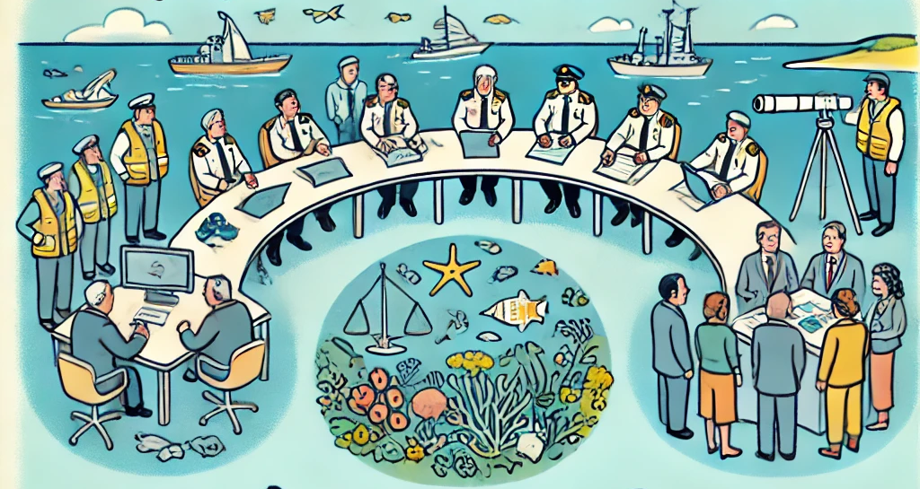
Key policy recommendations
Governance & Coordination
Dedicated biodiversity coordination frameworks
Cross-scale and cross-sector collaboration
MPA-Related planning
Redefine and align MPA objectives with MSP
Include MPAs in spatial and regulatory planning
Support for OECMs and strictly protected areas
Legally Binding Biodiversity Targets
Integrate into sectoral policies and MSP processes
Monitoring, enforcement, and performance reviews

Slide 65
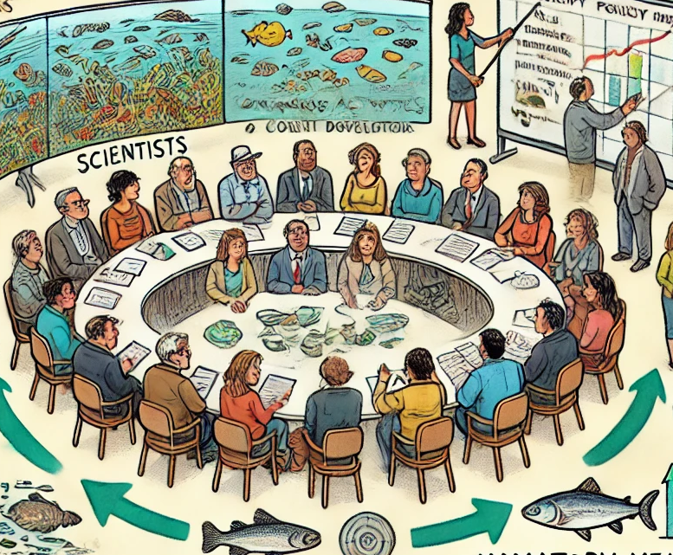
Key policy recommendations
Stakeholder & institutional Capacity
Permanent stakeholder platforms
Engage research institutions and communities
Training for MSP practitioners on biodiversity integration
E-learning and dialogue forums
Tools, data, and assessment
Standardized biodiversity assessment & reporting
FAIR data principles, interoperable platforms
Use of cumulative impact tools & scenario planning

Slide 66
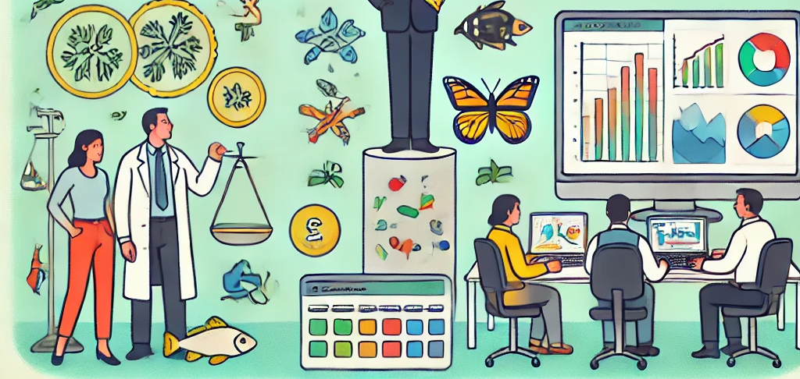
Key policy recommendations
Funding and Research
Dedicated biodiversity funds (e.g., from maritime taxes)
Support for adaptive MPA management
Long-term monitoring and cross-border research
Climate-Smart MSP
Integration of climate adaptation and mitigation
Ecosystem-based and nature-based solutions
Climate vulnerability assessments

Slide 67
Call for action
Embed biodiversity targets in all maritime policies
Institutionalize coordination and stakeholder engagement
Align MSP with MSFD and EU Nature Restoration Law
Invest in data, tools, and capacity building
Joint policy brief with relevant EU projects, in progress.

Slide 68
MSP4BIO
Policy recommendations for enhancing conservation in MSPs
Science Policy Dialogue Think Tanks - How can our projects directly support policy in enhancing conservation in MSP?
Mauro Randone, WWF-Mediterranean
Webinar: How Can Maritime Spatial Planning Help Achieve Europe’s 30×30 Targets?
6 June 2025, online
www.msp4bio.eu
@MSP4BIO_project
MSP4BIO

Slide 69
MAIN OBJECTIVE OF THE THINK TANKs
The main objective of the Science Policy Dialogues Think Tanks is to co-develop key recommendations in collaboration with linked projects and achieve validation through the engagement with policy actors.
Specific objectives:
•Collaboration with sister projects and relevant initiatives
•Coordinated engagement of policy stakeholders
•Co-development of recommendations
•Joint communication of scientific outputs to policy makers in a simple form
•Scrutinize outputs against policy coherence criteria

Slide 70





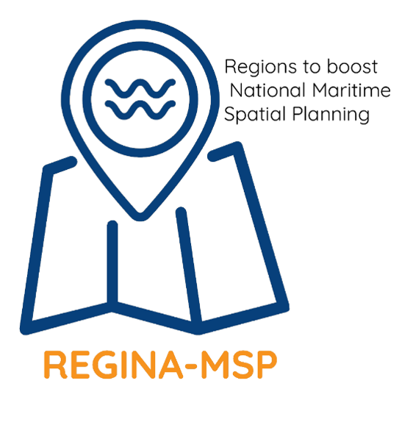
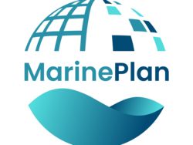


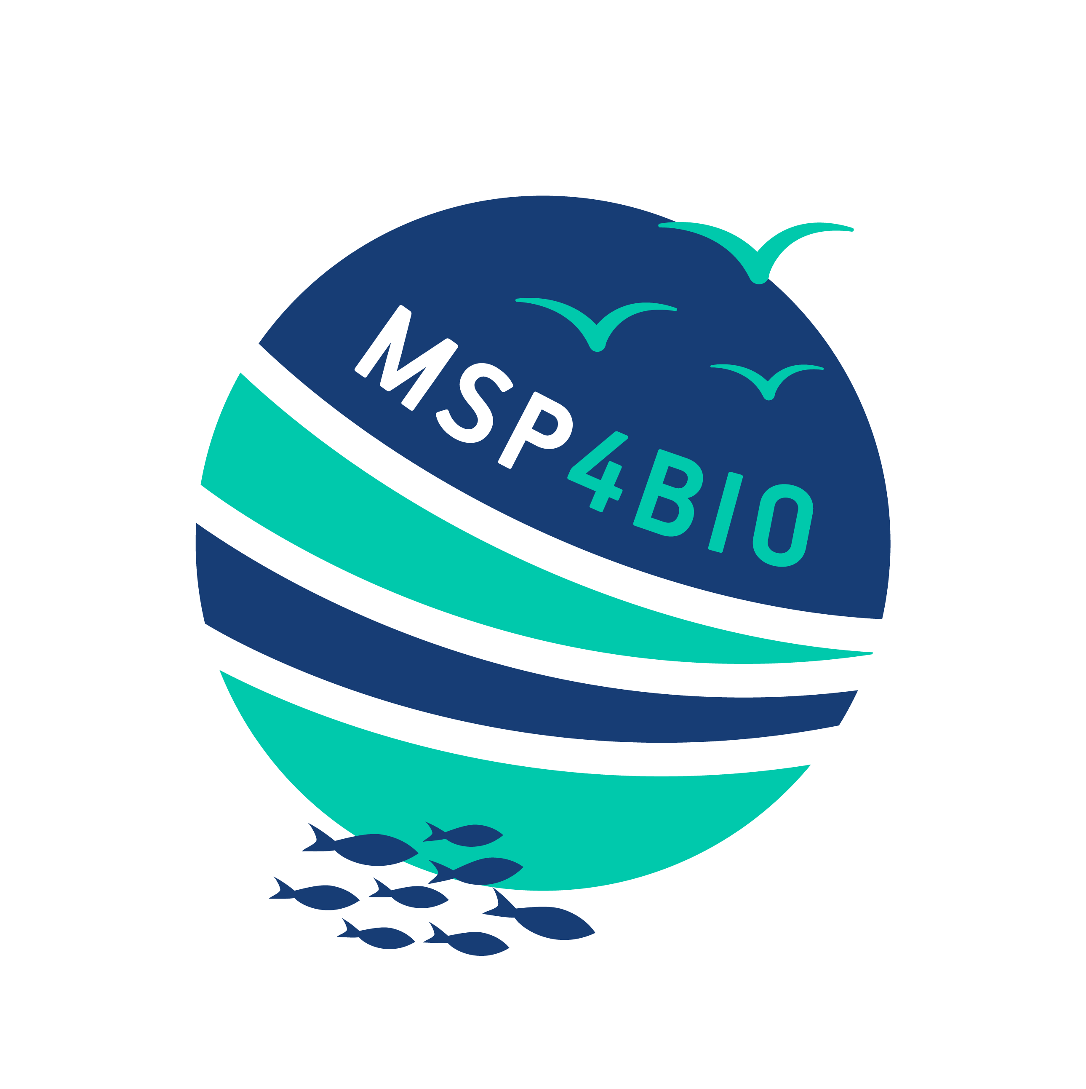
Different tools and outcomes from sister projects
Policy briefs, guidelines, toolkits, …
Feedback from previous Think Tanks & 1-1 meetings
Mapping of the projects main tools & outcomes

Slide 71
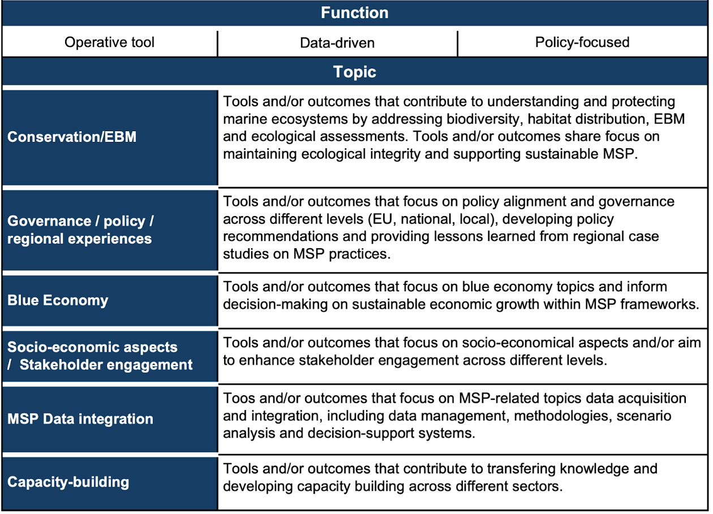
Methodology
Using Social Network Analysis (SNA) to create a visual graph showcasing the connections between the different tools and outcomes.

Slide 72
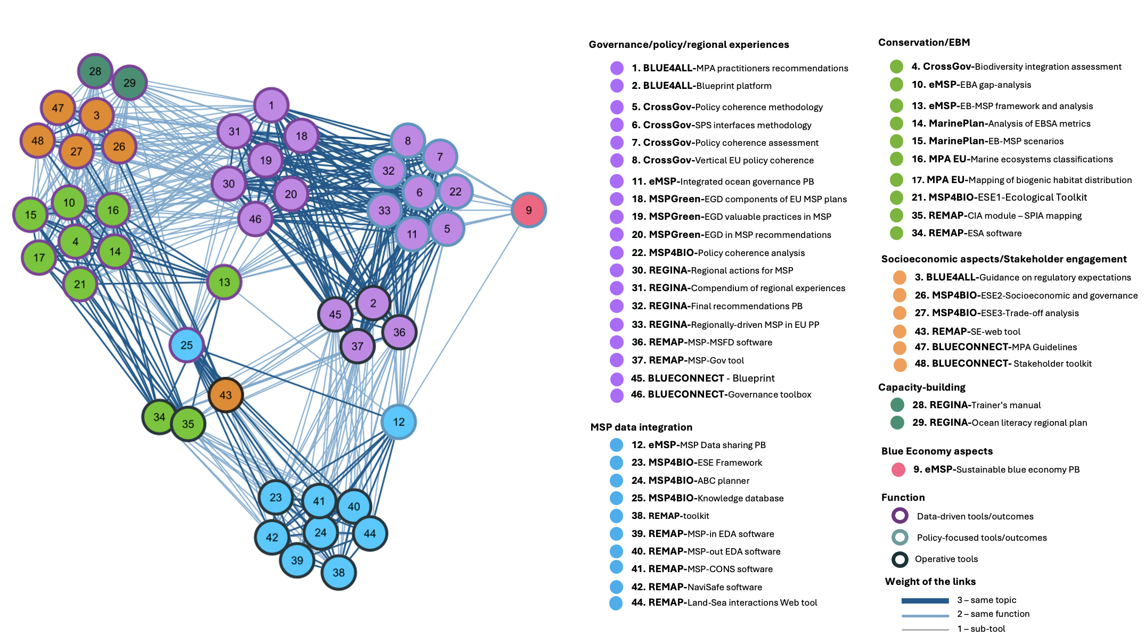

Slide 73
MSP4BIO
Next steps for the MSP Directive and marine protection
Presenting the perspectives for meeting EU spatial goals
Celine Frank, DG MARE - European Commission
Webinar: How Can Maritime Spatial Planning Help Achieve Europe’s 30×30 Targets?
6 June 2025, online
www.msp4bio.eu
@MSP4BIO_project
MSP4BIO

Slide 74
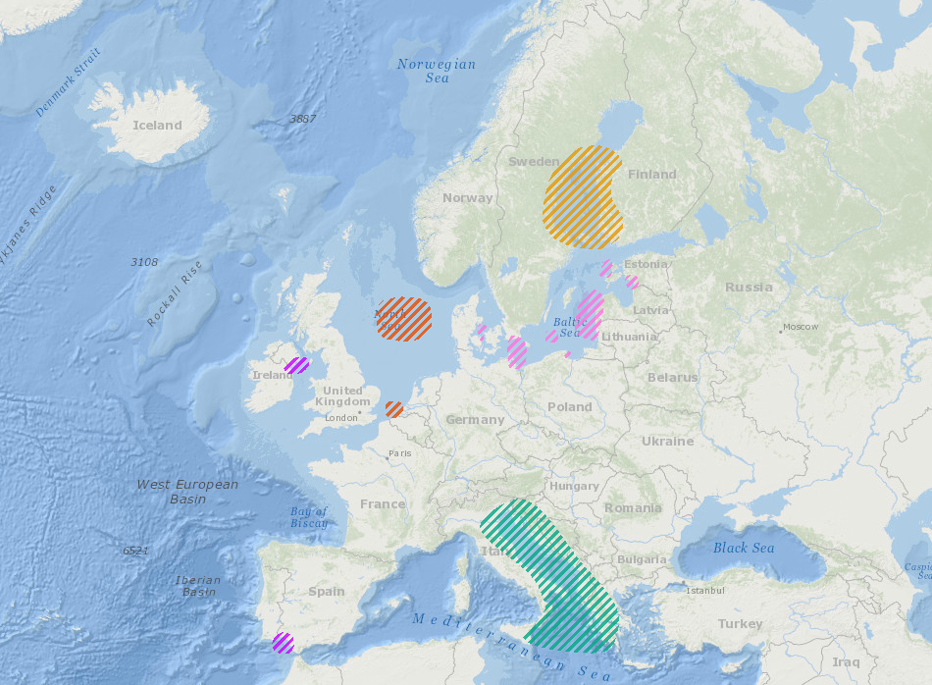
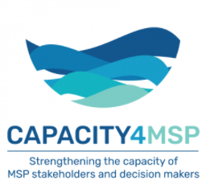


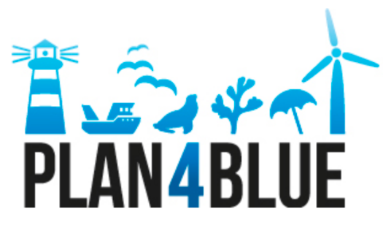
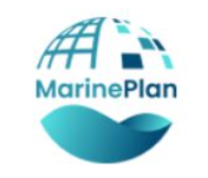














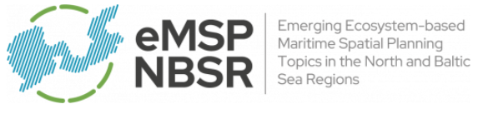




















EMFF EMFAF FUNDED
R&D FUNDED
INTERREG FUNDED
« IMP » FUNDED
FSE FUNDED
REGINA-MSP
MSP-GREEN
ReMAP
Notes:
More than 30 projects since 2014

Slide 75

Sharing access to EU marine space
Maritime Spatial planning: EU Directive – 1st COM report on implementation in 2022
Enough space allocated for EU energy targets but..
Biodiversity Strategy: 30% marine protected areas by 2030
+ Nature Restoration Regulation : 20% of sea restored by 2030 + 30% of degraded areas
→ National targets for restoration/protection to be established and integrated in MSP
Notes:
Baltic energy market interconnection plan (BEMIP)
NSEC working on scenarios for 2030: the percentage of the EEZ used for OWF in 2030 is highest in Belgium (13,3%) and lowest in Ireland (0.5%). For the entire study area, these percentages are 4.2% (OSPAR II) and 1.0% (OSPAR III)
Many MSs projects supported by TSI of REFORM

Slide 76

Example of maritime spatial plan
Multi-use encouraged in several Green Deal strategies
Guidance on multi-use with MPAs/Natura 2000 + EU Marine Action Plan
“the Commission will work with Member States to include areas for multi-use when revising national MSPs” Delivering on the EU offshore renewable energy ambitions
Notes:
Action Plan: Protecting and restoring marine ecosystems for sustainable and resilient fisheries

Slide 77



Multi-use and MSP
Online EU multi-use compendium

Slide 78

The European Ocean Pact

Slide 79

6 strategic objectives
“Ocean is water, water is life. That is why the European Ocean Pact is so important to us. This comprehensive strategy will protect the ocean and promote a sustainable blue economy. It will not only benefit the planet, but also the people who call the coast their home, and the generations who will steward our oceans tomorrow.”

Slide 80

Water resilience strategy
Source-to-Sea approach
Role of nature-based solutions – we need a range of different solutions
Climate adaptation Plan and further research and innovation to promote sustainable desalination.

Slide 81
Next steps
Report on implementation of the MSP Directive by March 2026 + launch of revision process
European Ocean Act by 2027
MSFD revision by 2027 – data and coherence with MSPD will be highlighted
Nature Restoration Regulation and MS plans
EU Ocean Observation Initiative + Operationalisation of the European DTO by 2030
Marine Action Plan + Vision 2040 for fisheries and aquaculture
Water Resilience Research and Innovation Strategy by 2026

Slide 82

Thank you! Questions?
Contact: celine.frank@ec.europa.eu
MARE-A2@ec.europa.eu

Slide 83
Q&A Session

Slide 84
MSP4BIO
Closing remarks
Final reflections and highlights
Marina Markovic, PAP/RAC
Webinar: How Can Maritime Spatial Planning Help Achieve Europe’s 30×30 Targets?
6 June 2025, online
www.msp4bio.eu
@MSP4BIO_project
MSP4BIO

